Slide 1
Entry Task: Lab Notebook 2/12/15
A procedure is a numbered list of steps someone can follow to repeat a process.
Watch the DNA extraction video.
Watch the video again, this time write down the key steps in extracting DNA from strawberries.
Compare your steps with your lab partner.
Practice agree/disagree and come up with a final procedure.

Slide 2
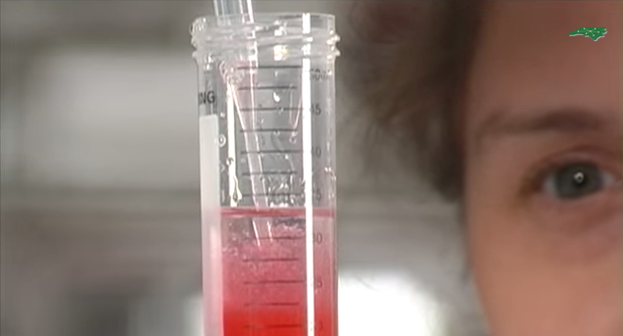
DNA Extraction Video
https://www.youtube.com/watch?v=vPGKv53zSRQ

