Slide 1
2/11/15 Objectives
Content Objective:
Model how specific nucleotide bases pair up in a molecule of DNA.
Language Objective:
Explain why specific nucleotide bases pair up in a molecule of DNA.

Slide 2
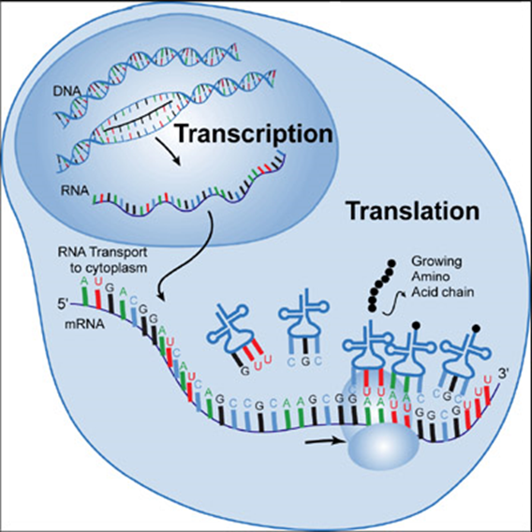
Entry Task: DNA Worksheet
Locate your DNA base pairing worksheet from yesterday. How far did you get?

Slide 3
Molecular Modeling
Working with your table partner, construct as many molecules of water (H₂O) as possible with one modeling kit.
Model how you think water molecules interact:
at 0℃ (freezing, 32℉)
at 25℃ (room temperature, 77℉)
at 100℃ (boiling, 212℉)
[°C] = ([°F] - 32) × 5/9
[°F] = [°C] × 9/5 + 32

Slide 4
Structured Partner Talk
Agree or disagree! Using A/B structured partner talk, discuss with your table partner whether you agree or disagree with thinking around how water molecules move at different temperatures and why.

Slide 5
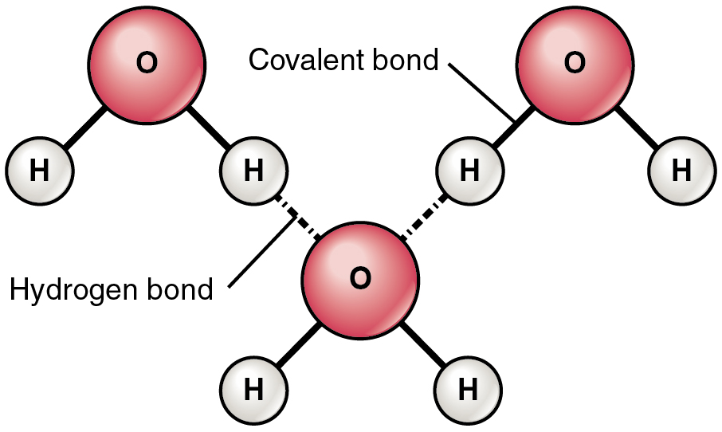
Introduction to Molecular Bonds

Slide 6
Covalent Bonds
When two atoms share electrons, a covalent bond is formed.
Single bonds are most common, although some atoms have double and even triple bonds.
Construct a molecule of carbon dioxide (CO₂). Compare and contrast CO₂ with H₂O. How are CO₂ with H₂O similar? How are they different?

Slide 7
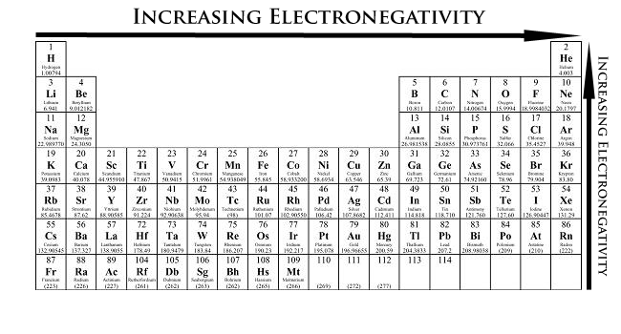
Electronegativity: A Measure of How Strongly Elements Want Electrons
H = hydrogen
C = carbon
O = oxygen
Looking at the periodic table, which element is more electronegative: hydrogen or oxygen? How about carbon or oxygen? How do you know?

Slide 8
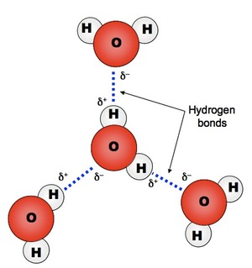
Hydrogen Bonds
In a molecule of water, hydrogen and oxygen share a covalent bond.
However, oxygen is more electronegative than hydrogen.
As a result, the electrons are pulled slightly away from the hydrogen atoms toward the oxygen atom.
This results in the oxygen atom having a partial negative (ẟ⁻) charge, and the hydrogen atoms having a partial positive (ẟ⁺) charge.
When water molecules interact, the ẟ⁻ oxygen atoms are attracted to the ẟ⁺ hydrogen atoms, creating hydrogen bonds.

Slide 9
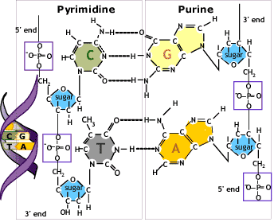
Types of Bonds in DNA
DNA is made of carbon (C), hydrogen (H), oxygen (O), nitrogen (N), and phosphorus (P). Can you find the covalent bonds? How about the hydrogen bonds?

Slide 10
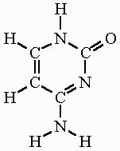
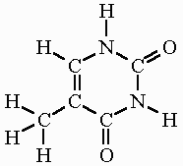
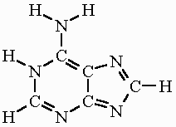
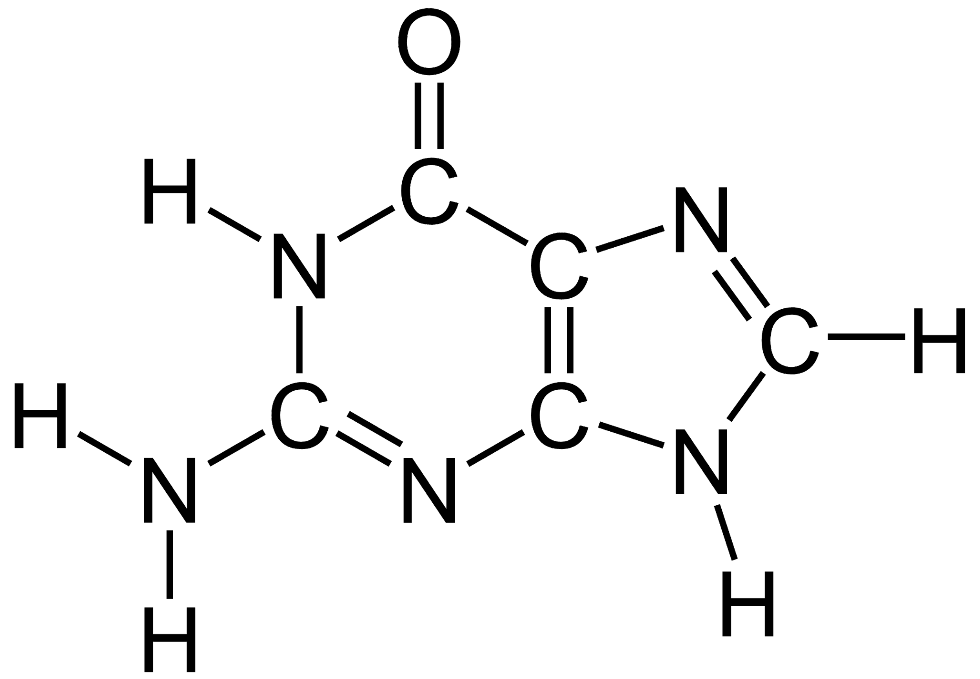
Nucleotide Bases
A = Adenine | C = Cytosine | G = Guanine | T = Thymine
How are the bases similar? Different?
Work with your partner to construct your assigned nucleotide base.

Slide 11
Nucleotide Base Interactions
Remember, in DNA, A pairs with T and C pairs with G. The pairs are called complementary bases.
Compare your assigned base with other groups assigned the same base. Are they constructed the same? Why or why not?
Find groups with your complementary base. Locate the atoms involved in hydrogen bonding between the two bases.

