Slide 1
Entry Task: Lab Notebook 2/4/15
Combustion is the process of burning organic molecules in the presence of oxygen to produce energy. Carbon dioxide and water are by-products of combustion. Fossil fuels are made of organic molecules (primarily hydrocarbons).
Write at least 4 sentences explaining your understanding of the unintended consequences of fossil fuel combustion.

Slide 2
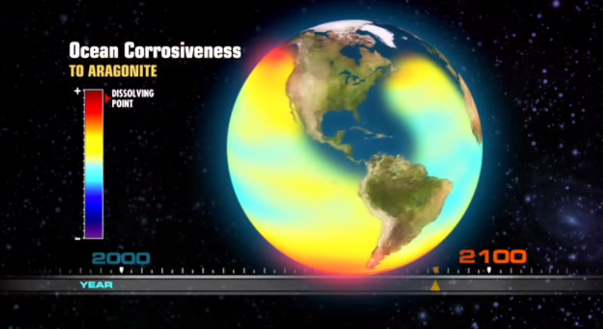
Acid Test: The Movie
https://www.youtube.com/watch?v=5cqCvcX7buo
http://www.nrdc.org/oceans/acidification/science.asp

Slide 3
Note Card
Name
How might ocean acidification directly affect you?
What is one question you still have?

Slide 4
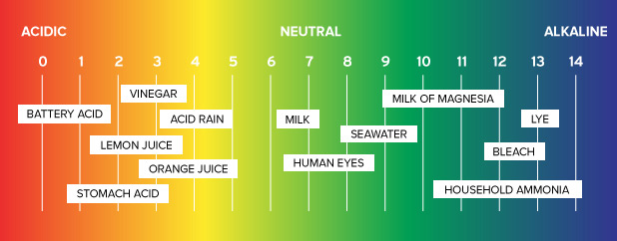
What is pH?
pH is a measure of acidity. Acidity refers to hydrogen ion (H⁺) concentration. The scale is logarithmic, meaning a pH of 6 is ten times more acidic than a pH of 7.

Slide 5
What is the Connection Between CO₂ and Acid?
Time for an experiment! You need:
A group of 4-5 people
A Vernier computer and a pH probe
A beaker filled with 100 mL of tap water
One straw for each student in the group

Slide 6
Experimental Procedure
Fill the beaker with 100 mL tap water.
Attach the pH probe to the computer.
Place the probe in the beaker. Measure and record the baseline pH of the tap water.
Take turns blowing into a straw for one minute. Record the starting and ending pH for each student.
pH/time: (starting pH (minus) ending pH) divided by # of seconds

Slide 7
Data and Analysis
Record the data on the worksheet. Work as a team to complete the analysis questions.
Turn in at the end of class.
Bonus: what is the effect of water temperature on this experiment?
Remember: computer lab tomorrow!!!

