Slide 1
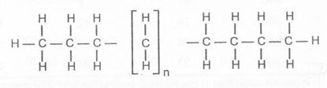
Entry Task: Lab Notebook 2/3/15
Draw a paraffin molecule with the formula C₁₀H₂₂

Slide 2
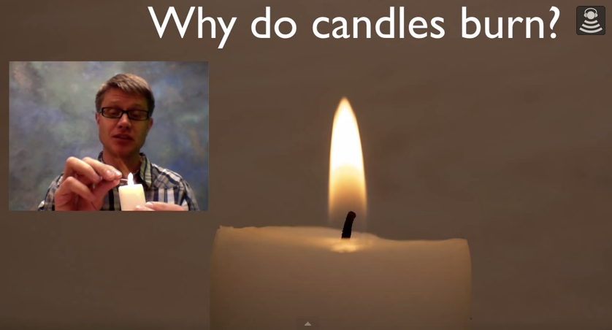
https://www.youtube.com/watch?v=6Dn0CW-KbvY
What happens to the mass of the candle? Where does it go?

Slide 3
Quiz

Slide 4
Challenge!
Silent work time
Balance the following equation on the back of your quiz:
__C₁₀H₂₂ + __O₂ → __CO₂ + __H₂O + heat
Notes:
2 C₁₀H₂₂ + 31 O₂ = 20 CO₂ + 22 H₂O

Slide 5
Conclusion Scoring
Add score (1-5) and multiply by 5
Revise for full credit!
CS – Conclusive Statement | /1
LC – Lowest Condition | /1
HC – Highest Condition | /1
EL – Explanatory Language | /1
SE – Scientific Explanation | /1

Slide 6
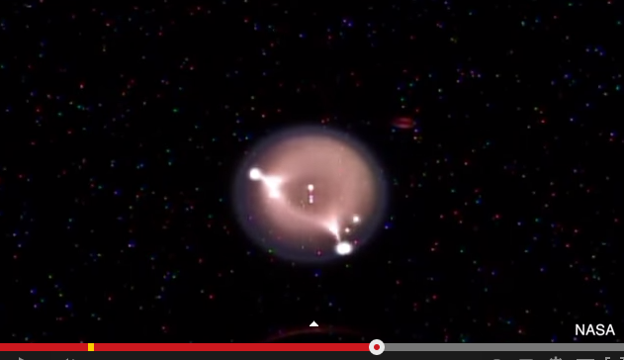
Combustion in Microgravity
https://www.youtube.com/watch?v=owwYSWEpL3g

