Slide 1
Your Vote Counted!
Central Dogma (DNA → RNA → Protein)
62%
Reproduction, Inheritance, and Meiosis
38%

Slide 2
Entry Task: Lab Notebook 2/2/15
Create and fill in the table in your lab notebook:
 | Inputs | Outputs
Photosynthesis
Cellular Respiration
Combustion

Slide 3
Vocabulary
In photosynthesis, the inputs (starting materials) are carbon dioxide (CO₂), water (H₂O), and sunlight energy. The outputs (ending materials) are glucose (C₆H₁₂O₆) and oxygen (O₂).
In chemistry, the inputs are called the reactants and the outputs are called the products.
Reactants → Products
Write the equation for photosynthesis and label the products and reactants.

Slide 4
Vocabulary
Chemistry is the study of matter and its properties.
Matter is something that has mass and takes up space.
The atom is the fundamental unit of matter. Atoms combine together in specific ways to form molecules.

Slide 5
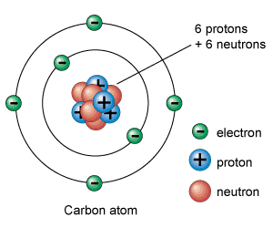
Vocabulary
Atoms consist of protons (+ charge), neutrons (neutral charge), and electrons (- charge).
Elements are defined by how many protons they have. For example, carbon has 6 protons:

Slide 6
Balancing Chemical Equations
In biology and chemistry, just like in math, both sides of an equation must be balanced.
Is the equation for photosynthesis balanced?
CO₂ + H₂O + sunlight → C₆H₁₂O₆ + O₂
Why or why not? How many atoms of carbon, oxygen, and hydrogen and in the reactants? How many in the products?

Slide 7
Balancing Chemical Equations
Photosynthesis Equation:
CO₂ + H₂O + sunlight → C₆H₁₂O₆ + O₂
 | Reactants | Products
Carbon | 1 | 6
Oxygen | 3 | 8
Hydrogen | 2 | 12
Is the equation balanced? How do you know?

Slide 8
Balancing Chemical Equations
To balance the equation for photosynthesis, we need to adjust the number of reactant and product molecules:
__CO₂ + __H₂O + sunlight → __C₆H₁₂O₆ + __O₂
6CO₂ + 6H₂O + sunlight → 1C₆H₁₂O₆ + 6O₂
 | Reactants | Products
Carbon | 6 | 6
Oxygen | 18 | 18
Hydrogen | 12 | 12
✔

Slide 9
Your turn! Working with a partner...
Balance the equation for cellular respiration.
Write the equation (Reactants → Products)
Adjust the number of reactant and product molecules
Check your work by filling in the table:
 | Reactants | Products
Carbon
Oxygen
Hydrogen

Slide 10
Your Turn!
Balance the following reaction:
CH₄ + O₂ → CO₂ + H₂O
Notes:
This is an example of a combustion reaction. Balanced: CH4 + 2O2 -> CO2 + 2H2O

Slide 11
Combustion
The process of burning organic compounds is called combustion.
In biology and chemistry, organic means “carbon-containing” molecules.
How many organic molecules can you list in one minute?

Slide 12
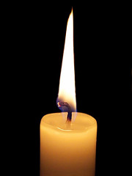
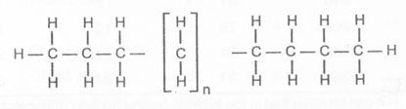
Why Do Candles Burn?
Candle wax is made of a substance called paraffin. Paraffins are long hydrocarbon molecules. The chemical formula of paraffin is C_{n}H_{2n+2} (example: C₂₀H₄₂).
A molecule of paraffin looks like:

Slide 13
Paraffin Wax
Imagine a molecule of paraffin wax with 10 carbon atoms. How many hydrogen atoms would the molecule have?
Explain your answer to your table partner.

