Slide 1
Entry Task: Lab Notebook 1/29/15
In your lab notebook, write and/or draw an answer to:
Where do trees get their mass from?

Slide 2
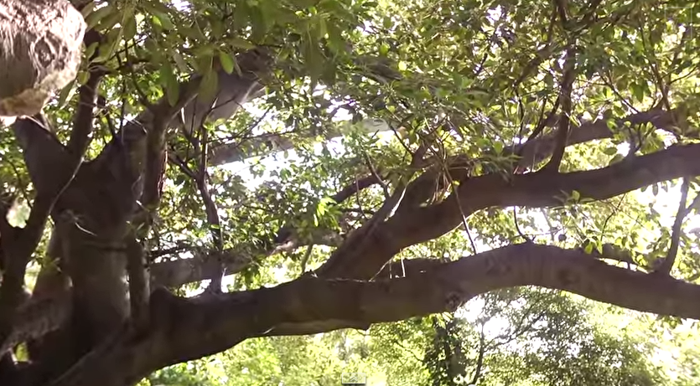
Where Do Trees Get Their Mass From?
https://www.youtube.com/watch?v=2KZb2_vcNTg

Slide 3
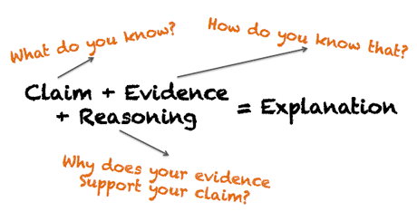
Revise Conclusions
In scientific writing, cut the fluff!

Slide 4
Conclusion = Explanation
Claim: Answer the experimental question - commit to a conclusive statement!
The MV affected the RV because...
Evidence: Back your claim with data! Explain the data extremes and include numbers.
Reasoning: Explain why the MV changed the RV using your understanding of the science.

