Slide 1
1/14/15 Objectives
Content Objective: Contrast how plants and seeds get the energy and nutrients they need to grow.
Language Objective: Write the Introduction section of your lab report.

Slide 2
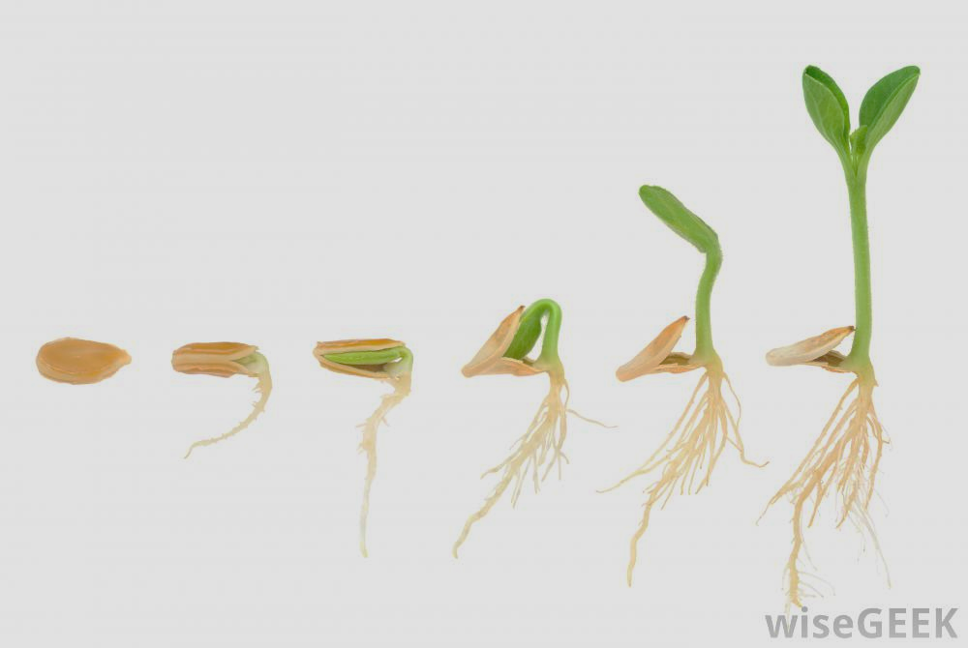
Entry Task: Lab Notebook 1/14/15
In your lab notebook, write at least 4 sentences explaining:
Where do seeds get energy to germinate?
What must seeds have in order to germinate?

Slide 3
Where Do Seeds Get Energy to Germinate?
Partner Share:
Partner A: explain idea to Partner B
Partner B: listen silently to understand A’s scientific thinking
Partner B: carefully revoice without judging, adapting, or agreeing/disagreeing
Partner A: clarify as needed
Partner B: be prepared to share with the class

Slide 4
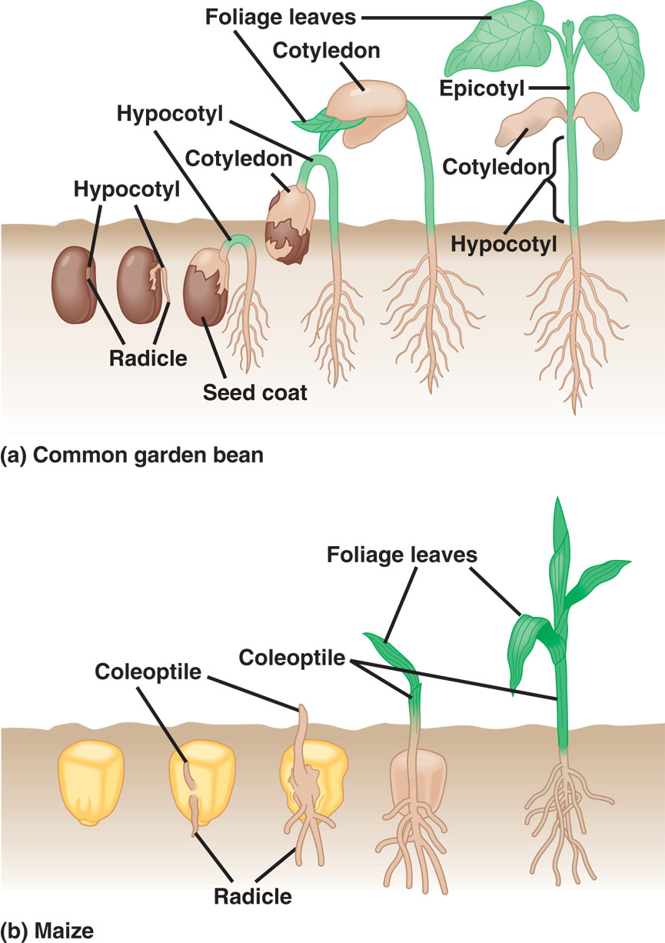
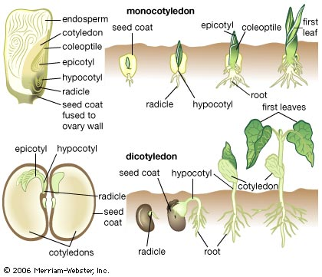
Dicot
Monocot

Slide 5
Silent Reading
In the textbook, turn to page 358. Read the section Controlling the Release of Energy from Matter: an Overview of Cellular Respiration (continues to page 359).
In your notebook, briefly describe the 3 main stages of cellular respiration. You may discuss with your table partner if desired.

Slide 6
Introduction Paragraph
What do you know about how plants obtain energy and nutrients? What about seeds?
What was the purpose of your experiment?
Experimental Purpose
Research Question
What do you think will happen in your experiment?
Hypothesis

Slide 7
Introduction Paragraph Consensus
Class Share Out:
Key ideas to include in the Introduction paragraph:

