Slide 1
Entry Task: Lab Notebook 1/13/15
Reflecting on your experimental data, do you think your manipulated variable is involved in seed germination? Why or why not?

Slide 2
1/13/15 Objectives
Content Objective: Identify the variables that affect seed germination.
Language Objective: Explain how your experimental data addresses your hypothesis.

Slide 3
Variables Tested
Lentils
Chia Seeds
Notes:
Seeds require water, the right temperature range, and oxygen to germinate.

Slide 4
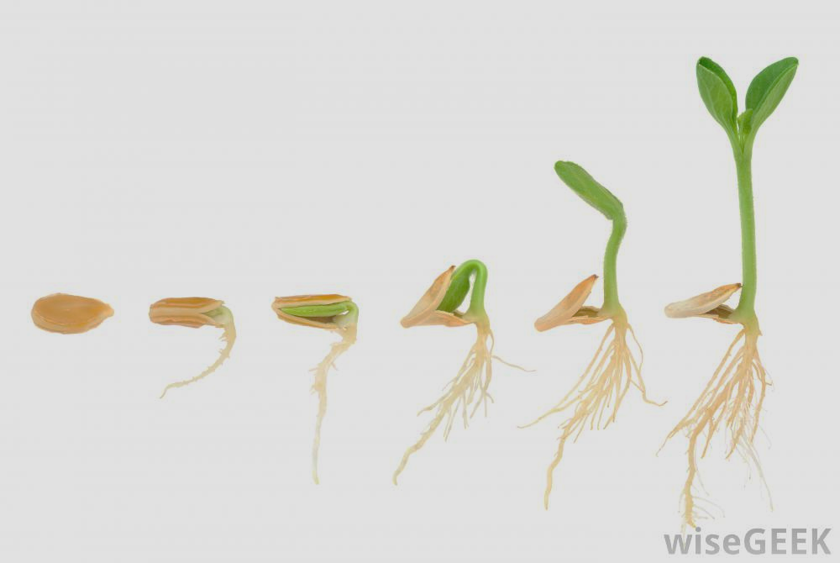
Germination
The process of seed germination and initial plant development requires energy. What is the source of this energy?
Notes:
Cellular Respiration! C6H12O6 + O2 -> CO2 + H2O + ATP

Slide 5
Reading
In your textbook, turn to page 358. Read the section Controlling the Release of Energy from Matter: an Overview of Cellular Respiration (continues to page 359).
In your notebook, briefly describe the 3 main stages of cellular respiration.
Time permitting, continue reading through page 365, taking notes in your lab notebook.

Slide 6
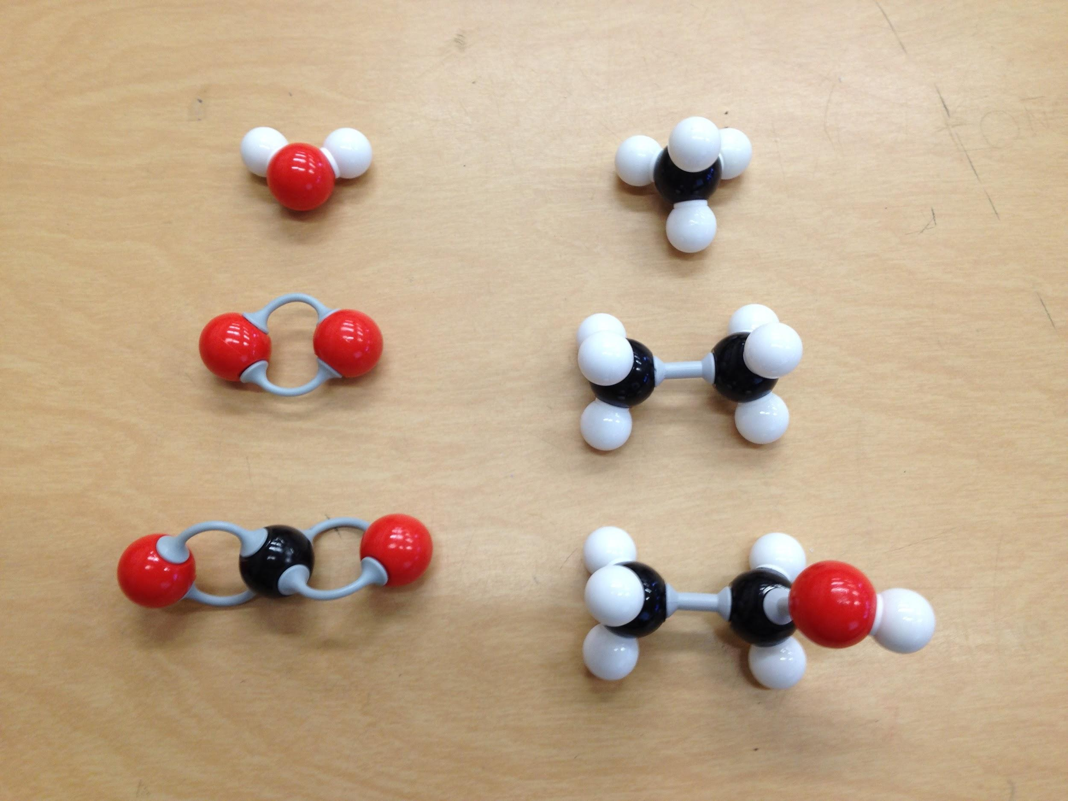
Building Molecules
Water (H₂O) Methane (CH₄)
Oxygen (O₂) Ethane (C₂H₆)
Carbon Dioxide (CO₂) Ethanol (C₂H₅OH)

