Slide 1
Entry Task: Lab Notebook 1/12/15
Review your data table from last week’s baggie garden experiment. Do you have enough data to confirm or disprove your hypothesis? Why or why not?

Slide 2
Weekly Vocabulary
Data Table
Analysis
Graph
Trend

Slide 3
1/12/15 Objectives
Content Objective: Complete your data table and begin analyzing the data.
Language Objective: Explain how your experimental data addresses your hypothesis.

Slide 4
Sections of a Lab Report
Introduction
Materials
Procedure
Results
Analysis
Conclusion

Slide 5
Results
Carefully controlled experiments allow us to test a hypothesis by evaluating the effect of a single manipulated variable.
We collect data to evaluate whether we confirmed or disproved our hypothesis.
Data is recorded in a lab notebook and organized in a data table.

Slide 6
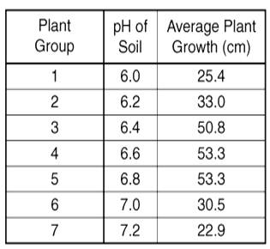
Analyzing Data
Analysis is the process of making sense out of data.
Now what?

Slide 7
Graphing
How can you graph your data to best illustrate your findings?
Options to consider when graphing:
Graph individual data points?
Calculate and graph averages? Deviation?
Single time point?
Change over time?

Slide 8
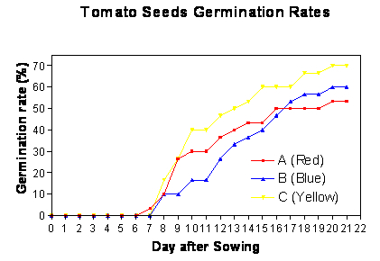
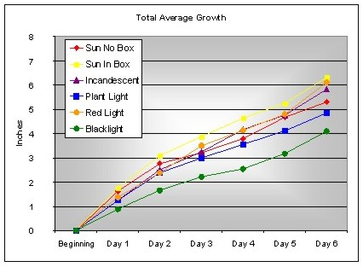
Analysis
We use graphs to help us make sense of data
Easier to see patterns or trends

Slide 9
Final Observations
For the remainder of the class period, make your final observations of your baggie gardens and enter your data in the data table in your lab notebook.
Extra credit: Take your seeds home, transplant them to soil, and continue making observations for your lab report.

Slide 10
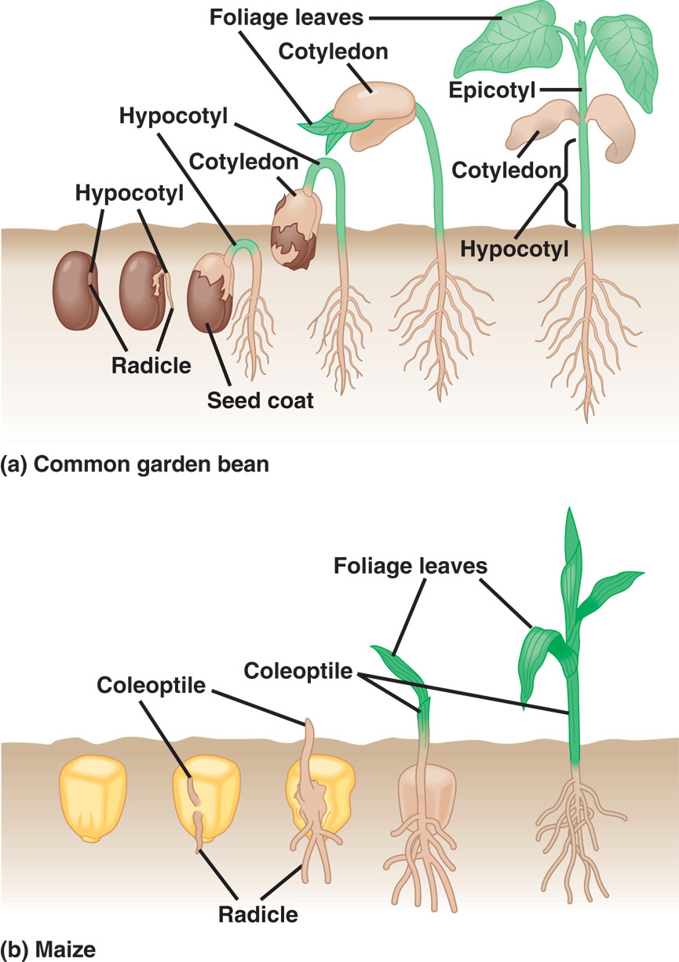
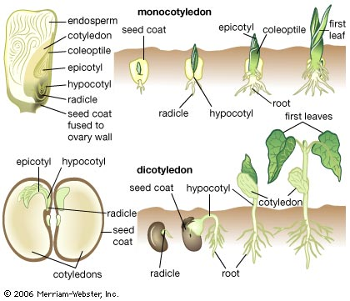
Dicot
Monocot

Slide 11
Exit Ticket
Did your results confirm or disprove your hypothesis? How do you know?
What are you going to do with your Baggie Gardens? Keep them or throw them away?

