Slide 1
Example
Ziploc bag
seeds
damp paper towel
1 2 3 4 5
Strategy: number the seeds and then monitor for germination
Data to collect: each day, observe the seeds and note the date each seed germinates

Slide 2
How Will You Record Your Data?
In your lab notebook! In a data table!
Observation Date | Seed ID # | Germination | Root Length (mm) | Shoot Length (mm)

Slide 3
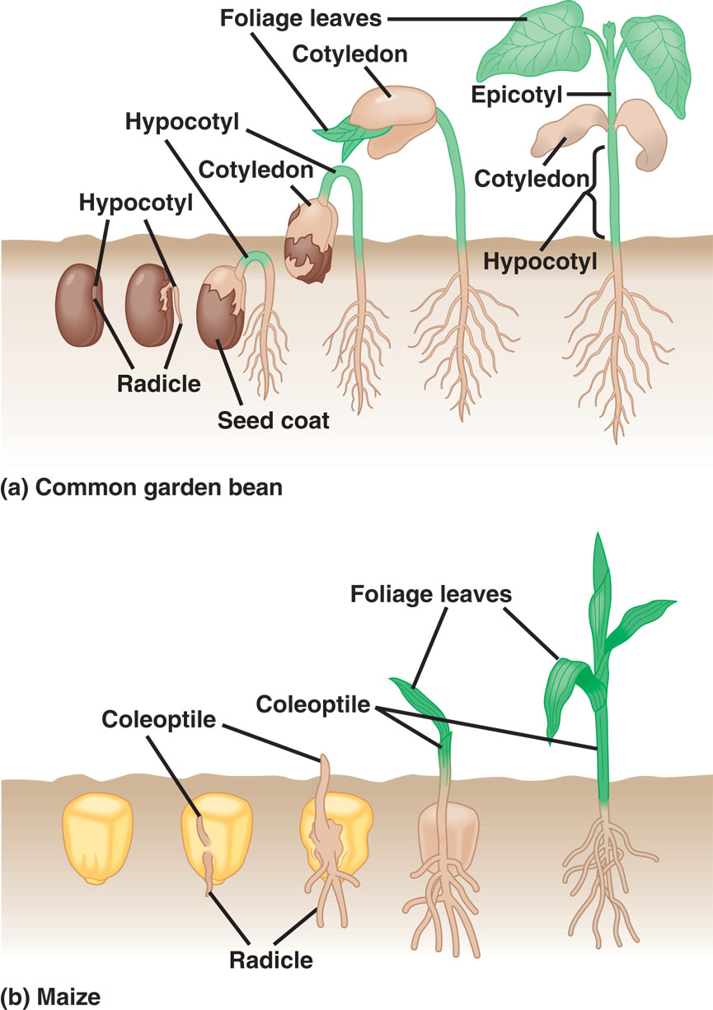
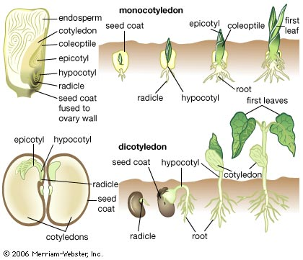
Dicot
Monocot

