Slide 1
1/7/15 Objectives
CO: Identify what to include in the Results section of a lab report
LO: Explain what data to collect for the Baggie Garden lab and why

Slide 2
Entry Task: Lab Notebook 1/7/15
In your lab notebook, write at least 4 sentences reflecting on your experience conducting the Baggie Garden lab yesterday.
What went well?
What could have gone better?
What surprised you?
What would you do differently today if you were to repeat the process?

Slide 3
Sections of a Lab Report
Introduction
Materials
Procedure
Results
Analysis
Conclusion

Slide 4
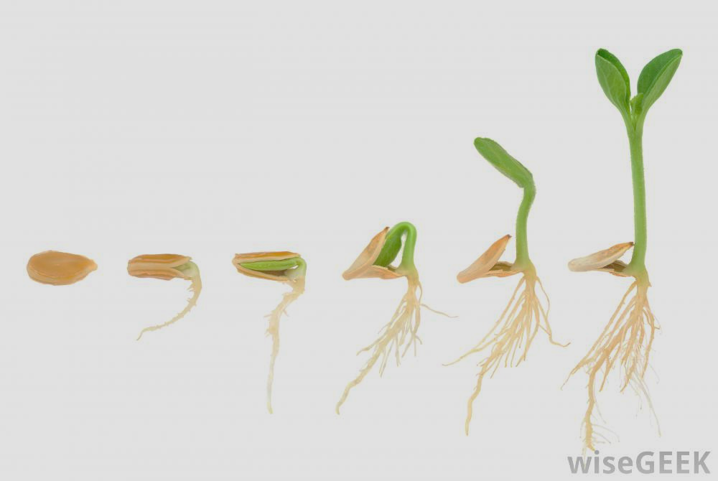
Results
What results are available to collect for this experiment?
germination!
shoot
root

Slide 5
Results
How do you decide which data to collect?
Strategy 1: Collect as much data as possible
Strategy 2: Select data pre-determined as relevant to your manipulated variable
With your lab partner, identify at least one “pro” and one “con” for each strategy.

Slide 6
Example
Research Question: How does the amount of water affect chia seed germination?
Hypothesis: If chia seeds are placed in a baggie garden with too little water, then they will not germinate because the seed will not hydrate enough to activate cellular respiration inside the seed.
Data to collect: date of germination of each seed

Slide 7
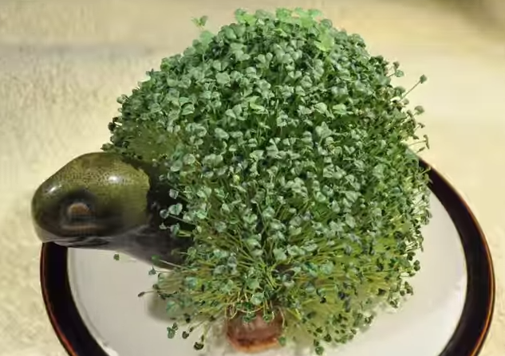
Ch-Ch-Ch-Chia!

Slide 8
Example
Ziploc bag
seeds
damp paper towel
1 2 3 4 5
Strategy: number the seeds and then monitor for germination
Data to collect: each day, observe the seeds and note the date each seed germinates

Slide 9
What Data Will You Collect?
Take a few minutes of private think time to decide which data you should collect in order to support or refute your hypothesis.
Remember: you want a solid connection between the Experimental Purpose, your Research Question, your Hypothesis, and your Experimental Procedure.

Slide 10
What Data Will You Collect?
Partner Share:
Partner A: explain idea to Partner B
Partner B: listen silently to understand A’s scientific thinking
Partner B: carefully revoice without judging, adapting, or agreeing/disagreeing
Partner A: clarify as needed
Partner B: be prepared to share with the class

Slide 11
How Will You Record Your Data?
In your lab notebook! In a data table!
Observation Date | Seed ID # | Observation 1 | Observation 2 | Observation 3

Slide 12
Baggie Garden Observation Time
Look closely at your seeds.
Make detailed observations in your lab notebook.
Work carefully and efficiently.
Exit Ticket due at the bell.

Slide 13
Exit Ticket
On a notecard, justify your data plan:
List what data you will collect and briefly explain why.
Sketch out your data table on the back of the card.
Turn the notecard in as you leave.

