Slide 1
1/5/15 Objectives
CO: Plan a scientific investigation, choosing a method appropriate to the question being asked.
LO: Explain variables affecting seed germination

Slide 2
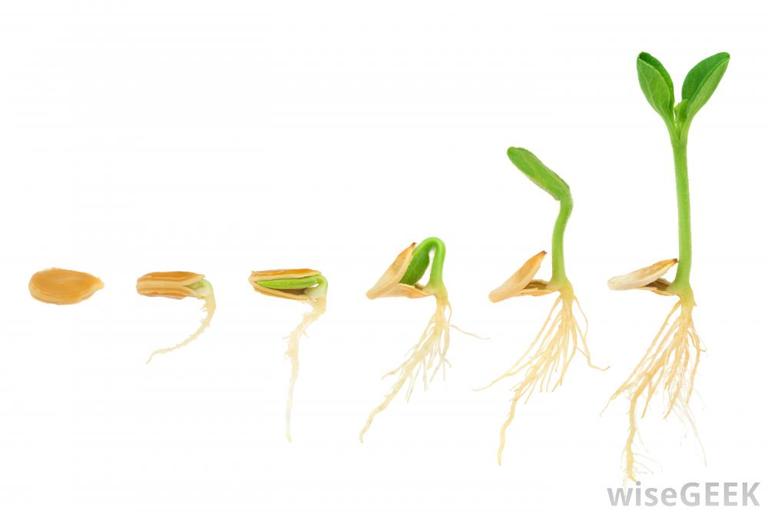
Entry Task: Lab Notebook 1/5/15
In your lab notebook, write at least 4 sentences describing variables that you think affect seed germination and explain your thinking.

Slide 3
Share Variables With Table Partner
Take turns sharing variables and explaining your thinking.
Document your discussion in your lab notebook:
Write down new variables and include “why”
Write down new “why” for shared variables
Be prepared to share at least one variable with the class and explain shared thinking (why).

Slide 4
Class List of Variables

Slide 5
Baggie Garden Experiment
Experimental Purpose:
To evaluate the conditions necessary for seed germination.
Ziploc bag
seeds
damp paper towel

Slide 6
Research Question
What do you want to learn?

Slide 7
FINER criteria for a good Research Question
Feasible - can the experiment be done?
Interesting - who is invested?
Novel - confirms, refutes, or extends previous findings
Ethical - who or what might be harmed?
Relevant - what will the experiment accomplish?

Slide 8
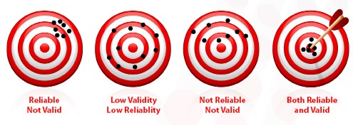
Reliability and Validity
repeated experimental trials
experimental control conditions

