Slide 1
Entry Task: Lab Notebook 12/8/14
Find your Great Salt Lake project team. You will have a few minutes to review audience feedback from your causeway presentation.

Slide 2
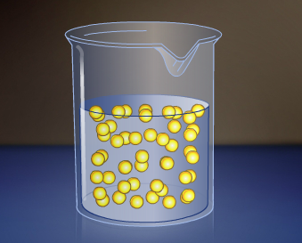
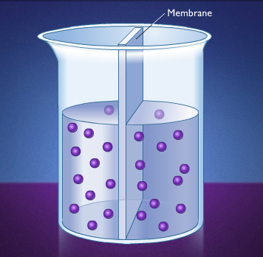
How Cells Eat: The Basics
Diffusion:
The movement of molecules from an area of high concentration to an area of low concentration
Osmosis:
The movement of small molecules across the cell’s lipid bi-layer plasma membrane
No carrier protein required
Bi-directional (concentration)

Slide 3
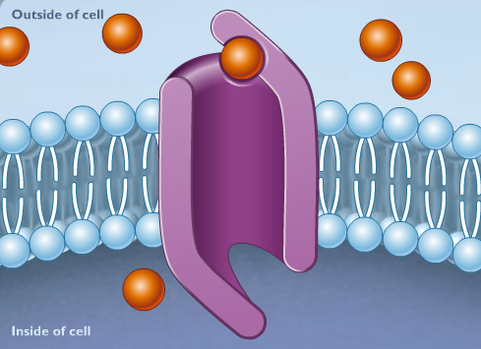
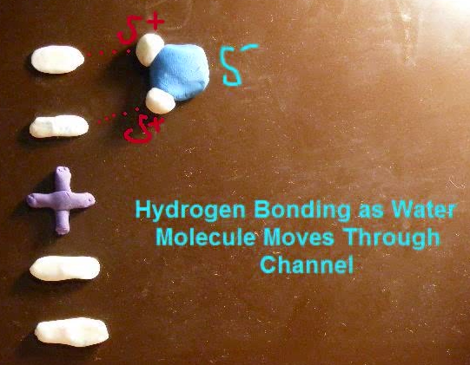
How Cells Eat: No Energy Mechanism
Facilitated Diffusion:
The movement of molecules across a membrane through a special carrier protein.
Bi-directional (transports molecules in and out of the cell based on concentration)

Slide 4
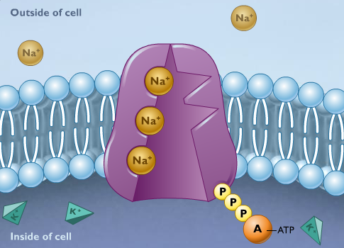
How Cells Eat: Energy Required!
Active Transport:
The movement of molecules across a membrane through a special carrier protein.
Movement of molecules against the concentration gradient (from low to high concentration) requires energy.
The molecule ATP supplies the energy

Slide 5
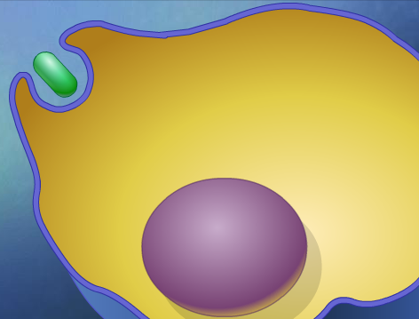
How Cells Eat: Bulk Transport
Endocytosis: The movement of nutrients into the cell through vesicles
Phagocytosis: food particles are engulfed by the cell membrane and brought into the cell
Pinocytosis: liquids only
Exocytosis: The discharge of material from vesicles at the cell surface to the outside of the cell

Slide 6
Application: Body Systems Project
You have just learned about how cells transport molecules across the plasma membrane.
Apply your understanding of at least one of these mechanisms to your body system project.
Bonus! Identify at least one solute carrier involved in nutrient transport. Visit http://slc.bioparadigms.org/ for a list of SLCs!

