Slide 1
Entry Task 12/3/14: Pop Quiz!
Please take a clicker and then enter your name at a computer station.
Sit in your assigned seat.
This is a quiz. Each question is worth 1 point.
Please be respectful of others. No talking or sharing answers.
Top scores win a prize!

Slide 2
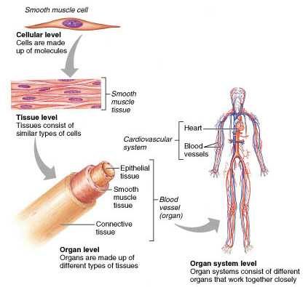
Levels of Cellular Organization

Slide 3
Josh Project!
Your team’s 5 minute presentation must include:
A poster with your assigned body system:
  Organs labeled
  Zoom-in and explanation of each major tissue type
  Zoom-in and explanation of major cell types
  Explanation of system functioning in healthy Josh
  Explanation of system functioning in sick Josh
Diagnose Josh - why is he sick?
  As the doctor, what lab test(s) should you order?
  What are the “normal” test values?
  Predict and explain sick Josh’s lab values
  Suggest a treatment and explain how that will affect Josh’s lab results

