Slide 1
Eggsperiment

Slide 2
Entry Task: Lab Notebook 11/12/14
Chicken eggshell is made of calcium carbonate. What types of aquatic organisms contain shells made of calcium carbonate?
Sea turtle eggs Hermit crab shell
Oysters Seahorse
Nautilus Coral
Snail Sea star = starfish
Clam Barnacles

Slide 3
Eggshell in Vinegar Chemistry
The simplified chemical formula for dissolving an eggshell in vinegar is:
CaCO₃+ 2H⁺ -> Ca²⁺ + H₂O +CO₂
CaCO₃ = calcium carbonate (eggshell)
H⁺ = hydrogen ion (from vinegar, pH 2.63)
Ca²⁺ = calcium ion
H₂O = water
CO₂ = carbon dioxide

Slide 4
Eggshell in Vinegar Chemistry (P2)
CaCO₃(s) + 2CH₃COOH(l) = Ca(CH₃COO)₂(s) + H₂O(l) + CO₂(g)
CaCO₃(s) = calcium carbonate (eggshell)
CH₃COOH = acetic acid (vinegar), pH
Ca(CH₃COO)₂= calcium acetate
H₂O = water
CO₂= carbon dioxide
Note: We used a 5% acetic acid solution (vinegar), which is 95% water. The pH was measured to be 2.63.

Slide 5
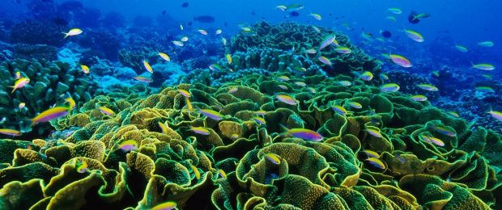
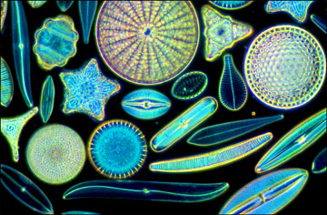
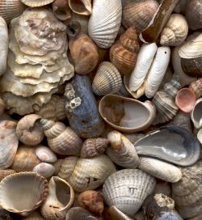
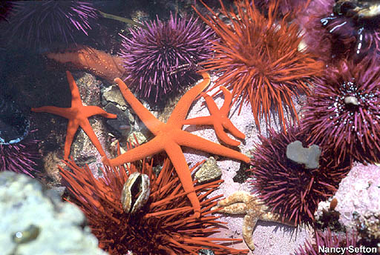
Partner Share: What might happen if the pH of the world’s oceans becomes more acidic?

Slide 6
Data Share-Out: Period 1
Time |  | Egg 1 | Egg 2 | Egg 3 | Egg 4 | Egg 5 | Average
8:00 | Room CO₂ | 380 ppm | 500 ppm | 470 ppm | 480 ppm | 480 ppm
8:00 | Cup CO₂ | 377 pm | 617 ppm | 250 ppm | 609 ppm | 40 ppm
8:00 | Room O₂ | 20.82% | 20.4% | 20.6% | 20% | 20%
8:00 | Cup O₂ | 20.38% | 20.28% | 19.7% | 20% | 20%
Convert ppm (parts per million) to % by dividing ppm by 10,000
Average Cup CO₂ - Average Room CO₂ =
Average Cup O₂ - Average Room O₂ =
What does this mean?

Slide 7
Data Share-Out: Period 2
Time |  | Egg 1 | Egg 2 | Egg 3 | Egg 4 | Egg 5 | Average
8:58 | Room CO₂ | 380 ppm | 500 ppm | 470 ppm | 480 ppm | 480 ppm
8:58 | Cup CO₂ | 7890 ppm | 19135 ppm | 6330 ppm | 9980 ppm | 10008 ppm
8:58 | Room O₂ | 20.33% | 20.10% | 20.34% | 20.44% | 21.27%
8:58 | Cup O₂
Convert ppm (parts per million) to % by dividing ppm by 10,000
Average Cup CO₂ - Average Room CO₂ =
Average Cup O₂ - Average Room O₂ =
What does this mean?

Slide 8
Data Share-Out: Period 3
Time |  | Egg 1 | Egg 2 | Egg 3 | Egg 4 | Egg 5 | Average
10:30 | Room CO₂ | 130 ppm | 700 ppm | 655 ppm | 710 ppm | 682 ppm
10:30 | Cup CO₂ | 26990 ppm | 63990 ppm | 43500 ppm | 96500 ppm | 66200 ppm
10:30 | Room O₂ | 20.04% | 19.85% | 20.04% | 20.19% | 21.32%
10:30 | Cup O₂ | 17.01% | 17.41% | 16.32% | 16.55% | 17.81%
Convert ppm (parts per million) to % by dividing ppm by 10,000
Average Cup CO₂ - Average Room CO₂ =
Average Cup O₂ - Average Room O₂ =
What does this mean?

Slide 9
Data Share-Out: Period 4
Time |  | Egg 1 | Egg 2 | Egg 3 | Egg 4 | Egg 5 | Average
10:30 | Room CO₂ | 100 ppm | 468 ppm | 379 ppm | 514 ppm | 598 ppm
10:30 | Cup CO₂ | 32145 ppm | 90674 ppm | 60609 ppm | 99591 ppm | 97897 ppm
10:30 | Room O₂ | 20.21% | 20.1 % | 20.34% | 20.43% | 20.53%
10:30 | Cup O₂ | 17.24% | 17.82% | 18.21% | 16.53% | 18.79%
Convert ppm (parts per million) to % by dividing ppm by 10,000
Average Cup CO₂ - Average Room CO₂ =
Average Cup O₂ - Average Room O₂ =
What does this mean?

Slide 10
Data Share-Out: Period 5
Time |  | Egg 1 | Egg 2 | Egg 3 | Egg 4 | Egg 5 | Average
12:50 | Room CO₂ | 120 ppm | 215 ppm | 197 ppm | 150 ppm | 190 ppm
12:50 | Cup CO₂ | 27373 ppm | 50553 ppm | 41240 ppm | 77300 ppm | 35247 ppm
12:50 | Room O₂ | 20.08% | 17.03% | 22.16% | 19.95% | 21.7%
12:50 | Cup O₂ | 17.54% | 16.97% | 18.28% | 16.12% | 18.58%
Convert ppm (parts per million) to % by dividing ppm by 10,000
Average Cup CO₂ - Average Room CO₂ =
Average Cup O₂ - Average Room O₂ =
What does this mean?

Slide 11
Writing a Hypothesis Statement
Hypothesis: A proposed explanation made on the basis of limited evidence as a starting point for further investigation.
Put another way, a hypothesis is an educated guess about the outcome of an experiment.
It does not matter if your hypothesis is correct or not.
What matters is that your hypothesis can be tested scientifically.
A good hypothesis is written using the If...then...because... sentence structure.

Slide 12
Examples of Hypothesis Statements
If I open the faucet, then it will increase the flow of water because the faucet opening constrains water flow.
  Independent variable: faucet opening size
  Dependent variable: flow of water
If I raise the temperature of a cup of water, then the amount of salt that dissolves will increase because heat makes the molecules interact faster.
  Independent variable: temperature
  Dependent variable: amount of salt

Slide 13
Identify the Variables
If a plant receives fertilizer, then it will grow to be bigger than a plant that does not receive fertilizer because fertilizer removes the limiting factor of nutrient availability in soil.
  Independent/manipulated variable? Fertilizer
  Dependent/responding variable? Plant growth
  Controlled variables?
    Type of soil
    Amount of soil
    Type of pot
    Type of plant
    Amount of water
    Amount of sunlight

Slide 14
Eggsperiment Procedure - Part 1
Place chicken egg in plastic cup
Use a graduated cylinder to measure 100 mL vinegar
Pour vinegar into cup with egg and let sit for 3 days
After 3 days, carefully pour out vinegar in the sink and rinse shell-less egg with gently running water
  Use room-temperature water (not too hot or cold!)
Rinse cup with water and return egg to empty cup
  Wash your hands with soap and water!

Slide 15
Eggsperiment Procedure - Part 2
Using a triple beam balance, measure the mass of the egg and record in notebook
  Tare the balance with an empty cup before measuring the mass of the egg
Return the egg to the cup and wash hands!!!
Add 150 mL of assigned solution to cup with egg
  Tap water
  Distilled water
  Saturated salt solution
  Corn syrup
  Gatorade or soda (energy drink?)
Label cup with date, time, class period, initials and starting mass, then let sit 24 hours.

Slide 16
Non-negotiables
You will have a sub tomorrow. Behave.
Anyone touching eggs must wash hands! Raw eggs can carry Salmonella. Most persons infected with Salmonella develop diarrhea, fever, and abdominal cramps 12 to 72 hours after infection. You do not want this.
Accidents happen. Be careful, and clean up after yourself. Broken eggs go in the garbage. Clean with disinfectant wipes as needed.

