Slide 1
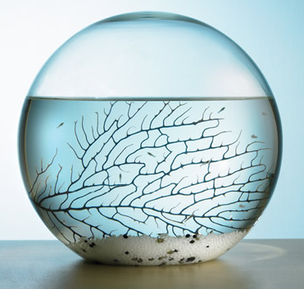
Entry Task: Lab Notebook 10/28/14
Thinking about the biospheres from yesterday, list at least three possible unintended consequences of introducing a non-native species into an ecosystem.

Slide 2
Private Think/Write #1
Does the amount of energy increase or decrease as you go up the food chain? Why?
Cite at least one source from your folder or notebook!

Slide 3
Share out
Practice A/B structured partner talk and share your answer to think/write #1 with a partner
Remember, you can use your lab notebooks and your folders for the exam.
You cannot use any electronics or other people for the exam.

Slide 4
Private Think/Write #2
Does the amount of matter increase or decrease as you go up the food chain? Why?
Cite at least one source from your folder or notebook!
Does the amount of matter available to the food chain increase or decrease as you go up the food chain? Why?
Cite at least one source from your folder or notebook!

Slide 5
Share out
Class share-out

Slide 6
Private Think/Write #3
Why is it necessary for there to be more producers in a food web than consumers? Be sure to include the concept of energy moving through the pyramid as evidence.
Cite at least one source from your folder or notebook!

Slide 7
Share out
Practice A/B structured partner talk and share your answer to think/write #3 with a partner

Slide 8
Private Think/Write #4
Identify 3 things that are limiting factors to the Brine Shrimp in the Great Salt Lake ecosystem.

Slide 9
Pair and Share
You have 2 minutes to exchange ideas with as many classmates as possible - go!

Slide 10
Private Think/Write #5
Explain how the carrying capacity of the Northern Harrier could change year-to-year.

Slide 11
Share out
Practice A/B structured partner talk and share your answer to think/write #5 with a partner

