Slide 1
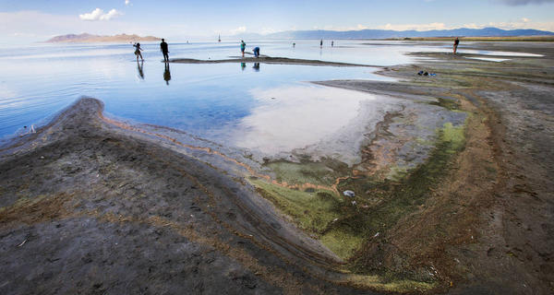
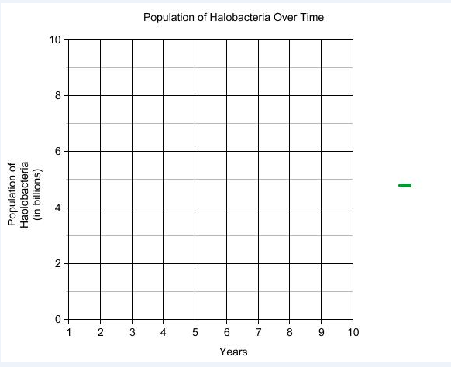

Entry Task
Over the last 3 years the water level of the Great Salt Lake
has dropped. Salinity of the GSL has increased.
Imagine that you started with 5 billion halobacteria in an area of the Great Salt Lake. Which of the following graphs best represents what would happen to the population of halobacteria? Use what you know about carrying capacity and limiting factors in your 4 sentence explanation.
Other/draw your own

