Slide 1
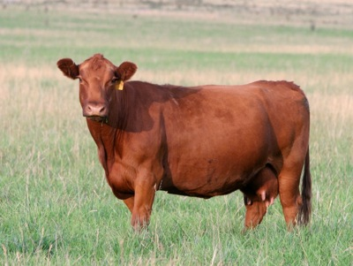
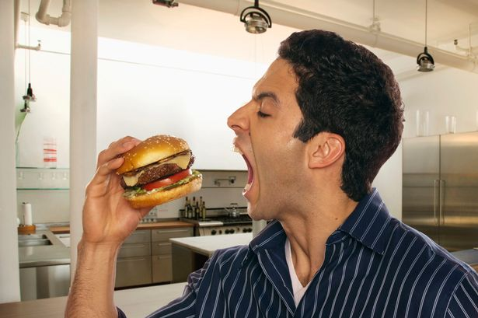
Entry Task: Lab Notebook 10/7/14
WHAT DO YOU THINK? AGAIN??
How much grass does a cow have to eat for us to eat one hamburger?

Slide 2
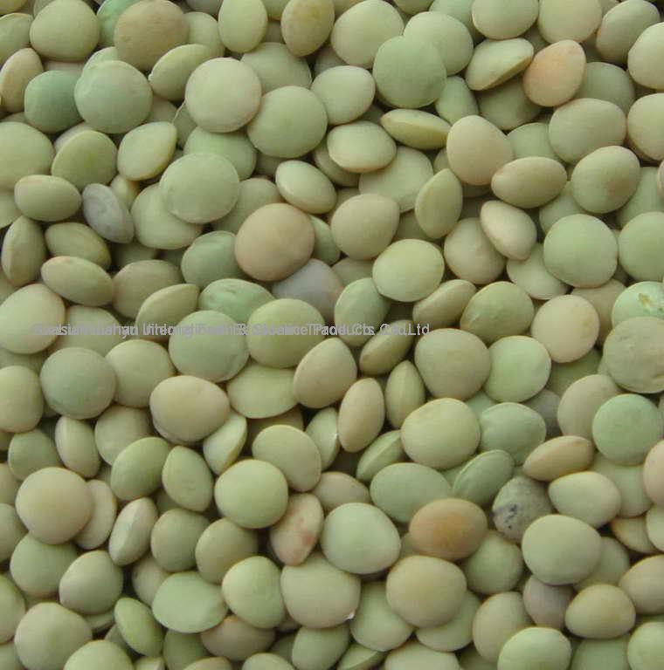
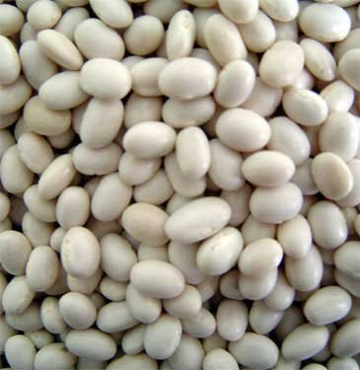
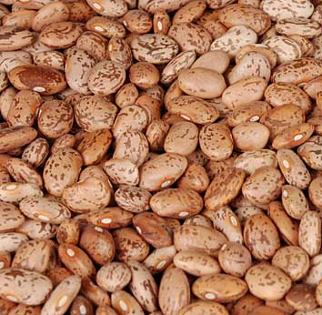
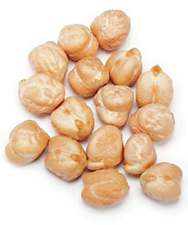
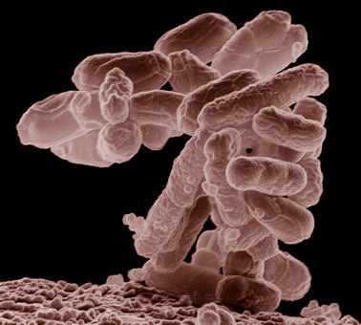
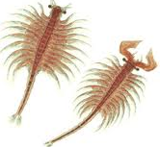
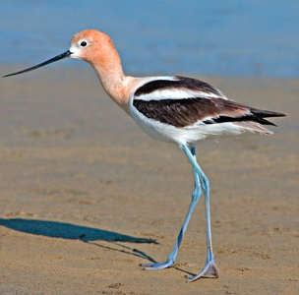
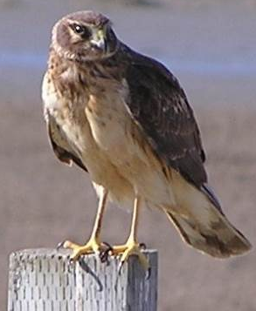
Great Salt Lake Food Chain
Halobacteria
Brine Shrimp
Avocet
N. Harrier
Length: 5 µm 1cm 50 cm 40 cm

Slide 3
Data!!
What is the total mass of Halobacteria needed to feed one kilogram of Northern Harrier?
10 kg Halo = 1 kg Brine Shrimp → 10 kg Brine Shrimp
10 kg Halo x 10 kg Brine Shrimp = 100 kg Halo
100 kg Halo = 10 kg Brine Shrimp = 1 kg Avocet
100 kg Halo x 10 kg Avocet = 1000 kg Halobacteria!!
So 1000 kg Halobacteria = 1 kg Northern Harrier

Slide 4
The Results
 | #1 | #2 | #3 | #4 | #5 | #6 | #7 | #8 | Avg
Halobacteria
Brine Shrimp
Avocet
N. Harrier

Slide 5
Debriefing the Game
Did this game take longer than you thought to move up to each level?
  Why? Why not?
How difficult was it to get to the Northern Harrier level?
  Why?
Why did we have to stop the “game”?
  What does that do to the rest of the food chain?
  This is called “Carrying Capacity” and we’ll talk more about this in a later lesson.
Notes:
4th and 6th

Slide 6





How much energy moves up each level?
Not much. Why?
Movement
Maintenance
Waste
Growth and Reproduction

Slide 7
Vocabulary Words
Turn to your vocabulary section of your journal and add these words and the first few definitions.
Word | Definition
Food Chain
A single part of a food web.
Matter
Anything that takes up space and has mass. (solid, liquid, gas phases)
Energy
The ability for something to do work. (kinetic, potential, chemical, electrical energy types)
Biomass
How much living matter there is in a place.
Notes:
4th only on first word

Slide 8
Exit Ticket
Complete your Analysis Questions before you leave.
Turn it in to the box when you are done.
Notes:
5th

Slide 9
The Results – P1
 | #1 | #2 | #3 | #4 | #5 | #6 | #7 | #8 | Avg
Halobacteria | 690 | 650 | 350 | 650 | 593 | 520 | 200 |  | 522
Brine Shrimp | 69 | 65 | 35 | 70 | 54 | 50 | 20 |  | 52
Avocet | 6 | 6 | 3 | 5 | 5 | 5 | 2 |  | 5
N. Harrier | 0 | 0 | 0 | 0 | 0 | 0 | 0 |  | 0

Slide 10
The Results – P2
 | #1 | #2 | #3 | #4 | #5 | #6 | #7 | #8 | Avg
Halobacteria | 800 | 700 | 700 | 300 | 700 | 300 | 200 |  | 529
Brine Shrimp | 80 | 70 | 70 | 30 | 70 | 30 | 20 |  | 53
Avocet | 8 | 7 | 7 | 3 | 7 | 3 | 2 |  | 5
N. Harrier | 0 | 0 | 0 | 0 | 0 | 0 | 0 |  | 0

Slide 11
The Results – P3
 | #1 | #2 | #3 | #4 | #5 | #6 | #7 | #8 | Avg
Halobacteria | 820 | 1100 | 1700 | 450 | 1600 | 1000 | 700 | 140 | 939
Brine Shrimp | 82 | 110 | 171 | 45 | 160 | 100 | 70 | 14 | 94
Avocet | 8 | 10 | 17 | 4 | 16 | 10 | 7 | 1 | 9
N. Harrier | 0 | 1 | 1 | 0 | 1 | 1 | 0 | 0 | 1

Slide 12
The Results – P4
 | #1 | #2 | #3 | #4 | Average
Halobacteria | 1280 | 300 | 1000 | 500 | 770
Brine Shrimp | 128 | 30 | 100 | 50 | 77
Avocet | 12 | 3 | 10 | 5 | 8
N. Harrier | 1 | 0 | 1 | 0 | 1

Slide 13
The Results – P5
 | #1 | #2 | #3 | #4 | #5 | #6 | #7 | #8 | Avg
Halobacteria | 700 | 820 | 700 | 600 | 1000 | 1720 | 1320 |  | 980
Brine Shrimp | 70 | 82 | 70 | 60 | 100 | 172 | 132 |  | 98
Avocet | 7 | 8 | 7 | 6 | 10 | 17 | 13 |  | 10
N. Harrier | 0 | 0 | 0 | 0 | 1 | 1 | 1 |  | 0

