Slide 1
Cytoscape
Learning Target: I can use software to analyze a cell phone network.

Slide 2
Week | Title
1 | Networks (Intro, Construct, Analyze, Quiz)
 | Lesson 1: Introduction to Networks
 | Lesson 2: Analyze a Network
 | Lesson 3: Construct a Network
 | Lesson 4: Quiz
2 | Human System Projects
3 | Ecosystem / Field Work
4 | Cryptocurrencies / Modeling
Notes:
6th period

Slide 3
Outline for Today
Everyone needs to turn on and log in to a laptop and a pick up a handout
We will briefly review key network vocabulary and concepts
Each student will complete the cell phone simulation worksheet and turn it in by the end of class

Slide 4
Vocabulary Review (matching!)
Ecosystem
Biotic Factors
Abiotic Factors
Network
Nodes
Edges
Members of a network
Everything that exists in a particular environment
the relationships between the nodes (often shown as arrows)
Things that are not living
An interconnected or interrelated chain, group, or system
Living things

Slide 5
Vocabulary Review (matching!)
Ecosystem (b)
Biotic Factors (f)
Abiotic Factors (d)
Network (e)
Nodes (a)
Edges (c)
Members of a network
Everything that exists in a particular environment
the relationships between the nodes (often shown as arrows)
Things that are not living
An interconnected or interrelated chain, group, or system
Living things

Slide 6
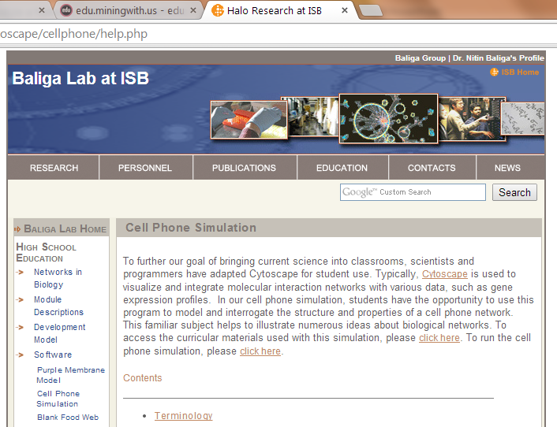
Launch Cytoscape Simulation
http://baliga.systemsbiology.net/cytoscape/cellphone/help.php
Click here

