Slide 1
Systems Biology

Slide 2
Part | Title
1 | Networks (Intro, Construct, Analyze, Quiz)
 | Lesson 1: Introduction to Networks
 | Lesson 2: Analyze a Network
 | Lesson 3: Construct a Network
 | Lesson 4: Quiz
2 | Human System Projects
3 | Ecosystem / Field Work
4 | Cryptocurrencies / Modeling
Notes:
6th period

Slide 3
An Introduction to Networks in Biology
Learning Target: I can apply systems thinking to analyze a simple cell phone network.

Slide 4
Outline for Today
Lab Notebook: In
Remembering ecosystem / food web
Learning about systems and networks
Work time activity
Simple cell phone network analysis
Lab Notebook: Out

Slide 5
Lab Notebook
New Unit: Ecosystems
New Activity: Introduction to Networks in Biology
Pair & Share
What is an ecosystem?
How could you represent an ecosystem on paper?

Slide 6
What is an ecosystem?
Ecosystem: Everything that exists in a particular environment
Biotic factors: Living things (like plants and animals)
Abiotic factors: Things that are not living (like rocks, air, sunlight, and water)

Slide 7
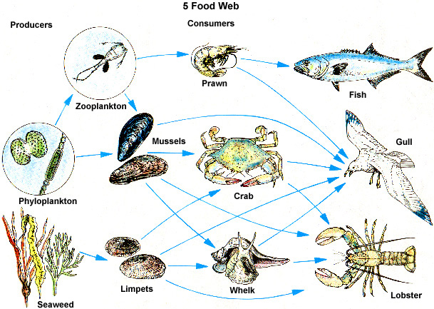
What is this?

Slide 8
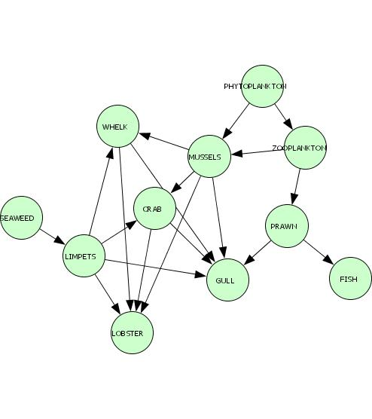
Network model of food web
The same Ocean Food Web

Slide 9
More Vocabulary Words
Network = an interconnected or interrelated chain, group, or system
Nodes = members of a network
Edges = the relationships between the nodes (often shown as arrows)

Slide 10
What do the nodes represent?
What do the edges represent?
The things in the ecosystem.
Who eats what.

Slide 11
Cell Phone Network
The nodes in this network are students and their cell phones, and the edges are arrows showing who can call whom
We can use this diagram to track the flow of information throughout the classroom
can call
1A
1D
edge
node
node

Slide 12
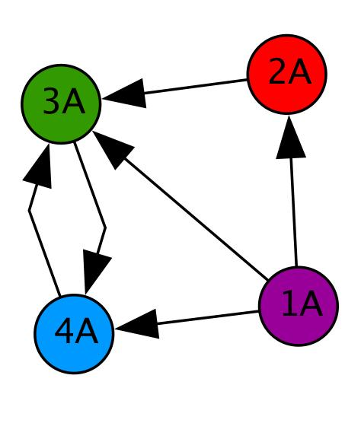
Cell Phone Network Analysis
The direction of the arrow is important in many networks.
In the example below, the single arrow pointing from 2A to 3A tells us that 2A can call 3A
  Notice that 3A cannot call 2A back, since there is no arrow pointing in that direction
edge
node
node
edge
edge
edge
edge
node
node
edge

Slide 13
Cell Phone Network:
Pop Quiz!
How many people can 1A call?
How many people can call 1A?
How many people can call 4A
If 2A hears a rumor, who else will find out about it?

Slide 14
Systems and Networks
Table Share activity:
  Come up with at least one example of a System:
    We selected the ______________ system because ______________
  Explain how the System could be modeled with a Network diagram. Remember to include:
    The nodes represent ______________
    The edges represent ______________
    The arrow direction of the edges show ______________
    The network diagram models the flow of ______________ through the system
Share with the class
Network = an interconnected or interrelated chain, group, or system.
Nodes = members of the network
Edges = the relationships between the nodes

Slide 15
Exit Ticket
Select an example of a system or network and suggest how your selection might be “crashed”
  Example: too many people calling at once can crash a cell phone network
What happens when an ecosystem crashes?

