Slide 1
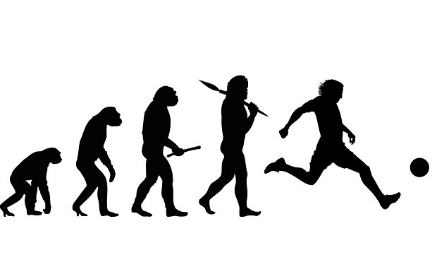
Lesson 1: Evolution

Slide 2
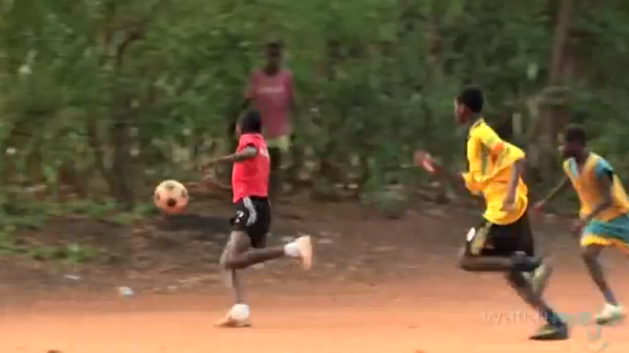
The Evolution of Soccer

Slide 3
What is Evolution?

Slide 4
Central Dogma
DNA mRNA Protein
Genome
Transcriptome
Proteome
The complete set of genetic information in an organism
The full range of mRNA molecules expressed by an organism
The complete set of proteins expressed by an organism

Slide 5
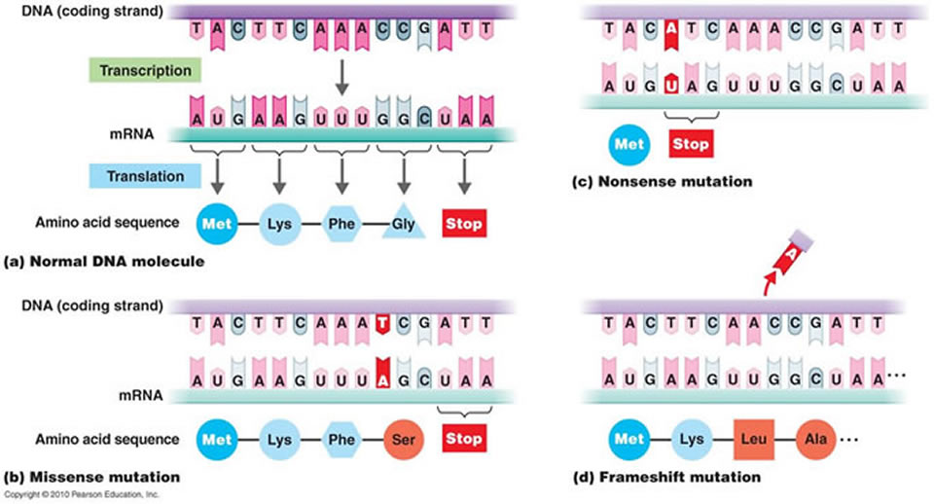
DNA Mutation: Missense

Slide 6
DNA Mutation: Nonsense

Slide 7
DNA Mutation: Frameshift

Slide 8
Remember…
DNA codes for RNA which codes for protein
RNA is translated into amino acid chains which fold up into proteins
When it comes to protein, if you change the structure then you change the function
Small changes in structure can have big effects on function

Slide 9
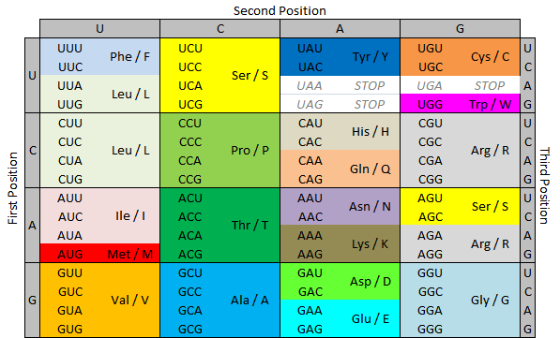
Amino Acid Decoder Chart

