Slide 1
Evolution
Lesson 2

Slide 2
Cells are the basic unit of life
Where do we find cells?
How do we know something is a cell?
Where did the first cells come from?
Notes:
What is the minimum number of cells that can define an organism?

Slide 3
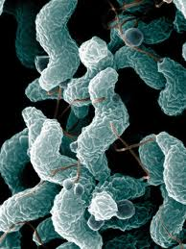
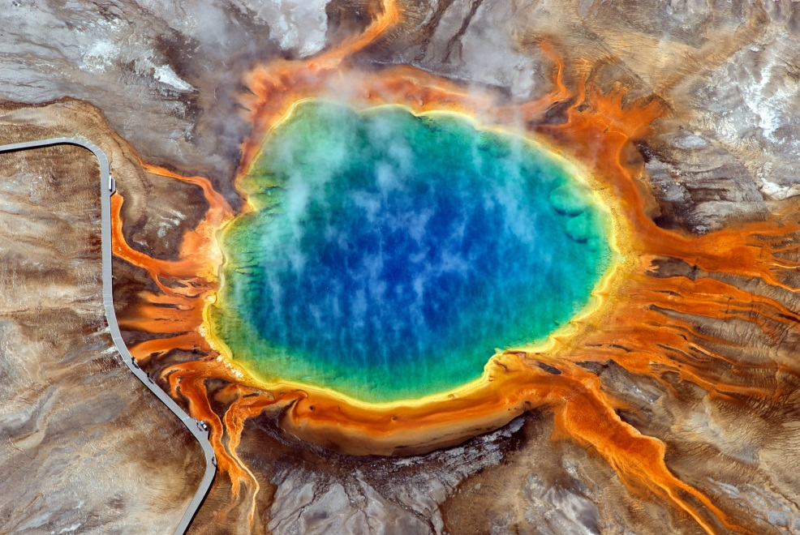
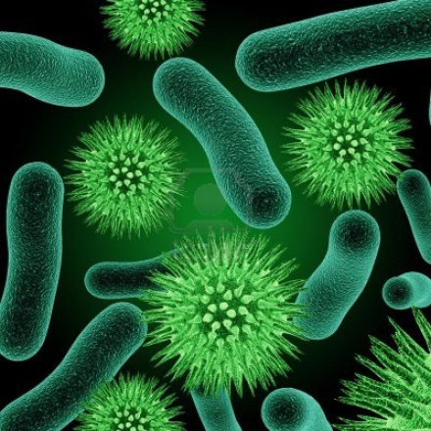
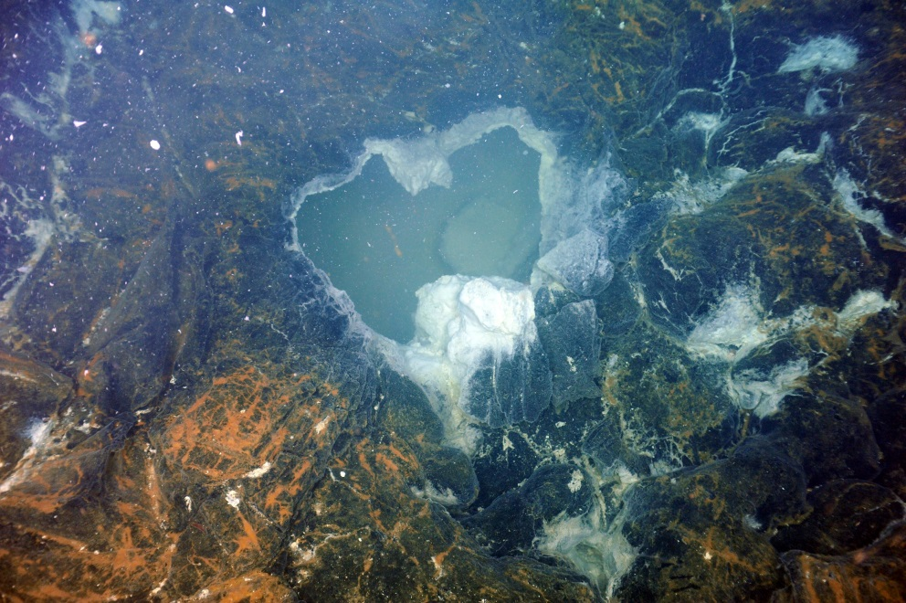
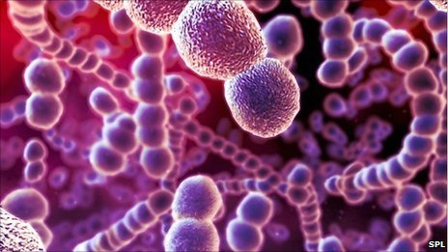
Bacteria are Everywhere
Notes:
Bacteria come in three main shapes: rod-shaped (bacilli), round (cocci), and spiral. Bacilli and cocci-shaped bacteria are often found attached in long chains. Bacteria are thought to have first evolved near undersea vents or near hot springs where the environment is warm and rich in the nutrients cells need to survive. The upper right picture is of the Grand Prismatic Spring at Yellowstone National Park. The lower left picture was taken of the ocean floor. Bacteria are brightly colored in both pictures.

Slide 4
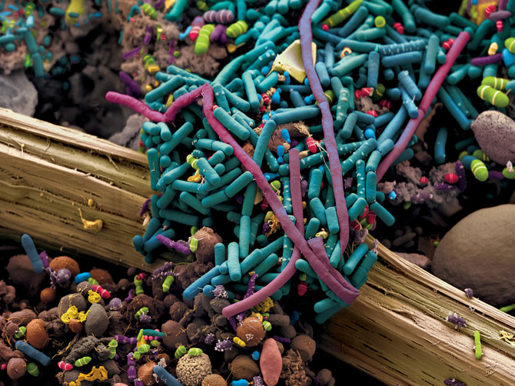
Bacteria Live In Your Guts
http://ngm.nationalgeographic.com/2013/01/125-microbes/oeggerli-photography#/05-intestinal-bacteria-670.jpg
Notes:
What do you see? This is a false-color image taken of a section of intestine. Note the various types of bacteria present (bacillia).

Slide 5
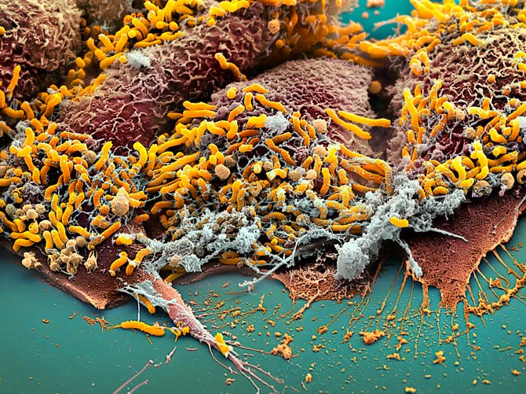
Bacteria Live in Your Stomach
Notes:
What do you see? This is a false-color image of a section of stomach. Helicobacter pylori bacteria are shown in yellow. They thrive in an acidic environment like the stomach and cause stomach ulcers and stomach cancer.

Slide 6
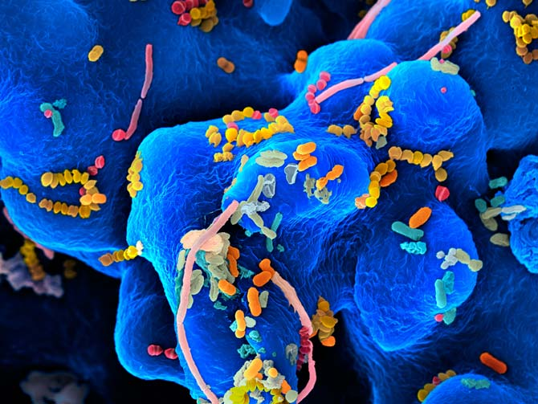
Bacteria Live in Your Mouth
Notes:
What do you see? These bacteria live in your mouth. They thrive in warm, moist places, and are responsible for morning breath and cavities. Proper dental care helps keep these bacteria in check.

Slide 7
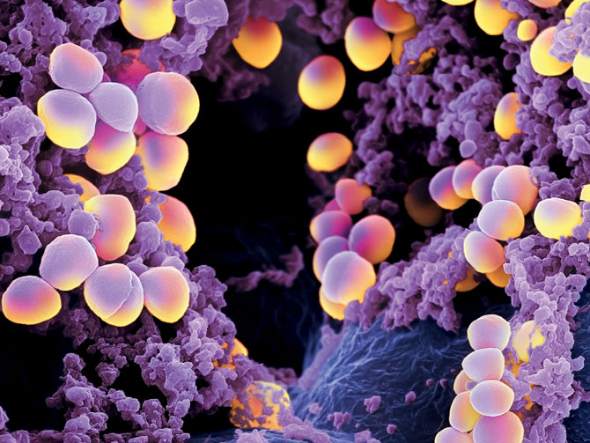
Bacteria Live in Your Nose
Notes:
What do you see? These cocci-shaped bacteria are called Staphylococcus aureus. They live in your nose and set sail any time you sneeze. The antibiotic methicillin is commonly used to treat Staph aureus infection. Recently, a strain of methicillin-resistant Staph aureus, or MRSA, has emerged and which is extremely difficult to treat. Given what you know about DNA and evolution, how do you think bacteria become resistant to antibiotics?

Slide 8
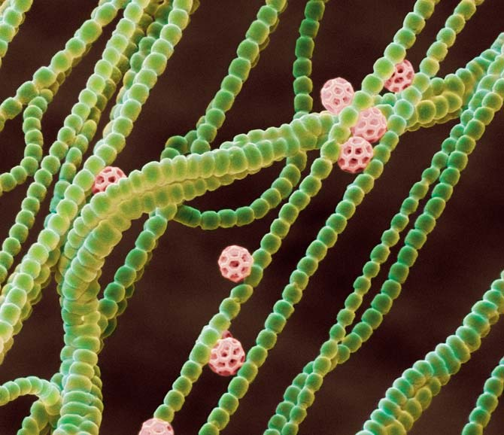
Got Oxygen? Thank Cyanobacteria!
Notes:
Cyanobacteria form long chains in the ocean and produce vast amounts of the oxygen we breath. The evolution of these bacteria literally changed the world. Before cyanobacteria, oxygen was not present in the atmosphere. Thanks to the endosymbiotic relationship between plants and cyanobacteria, plants are able to do photosynthesis.

Slide 9
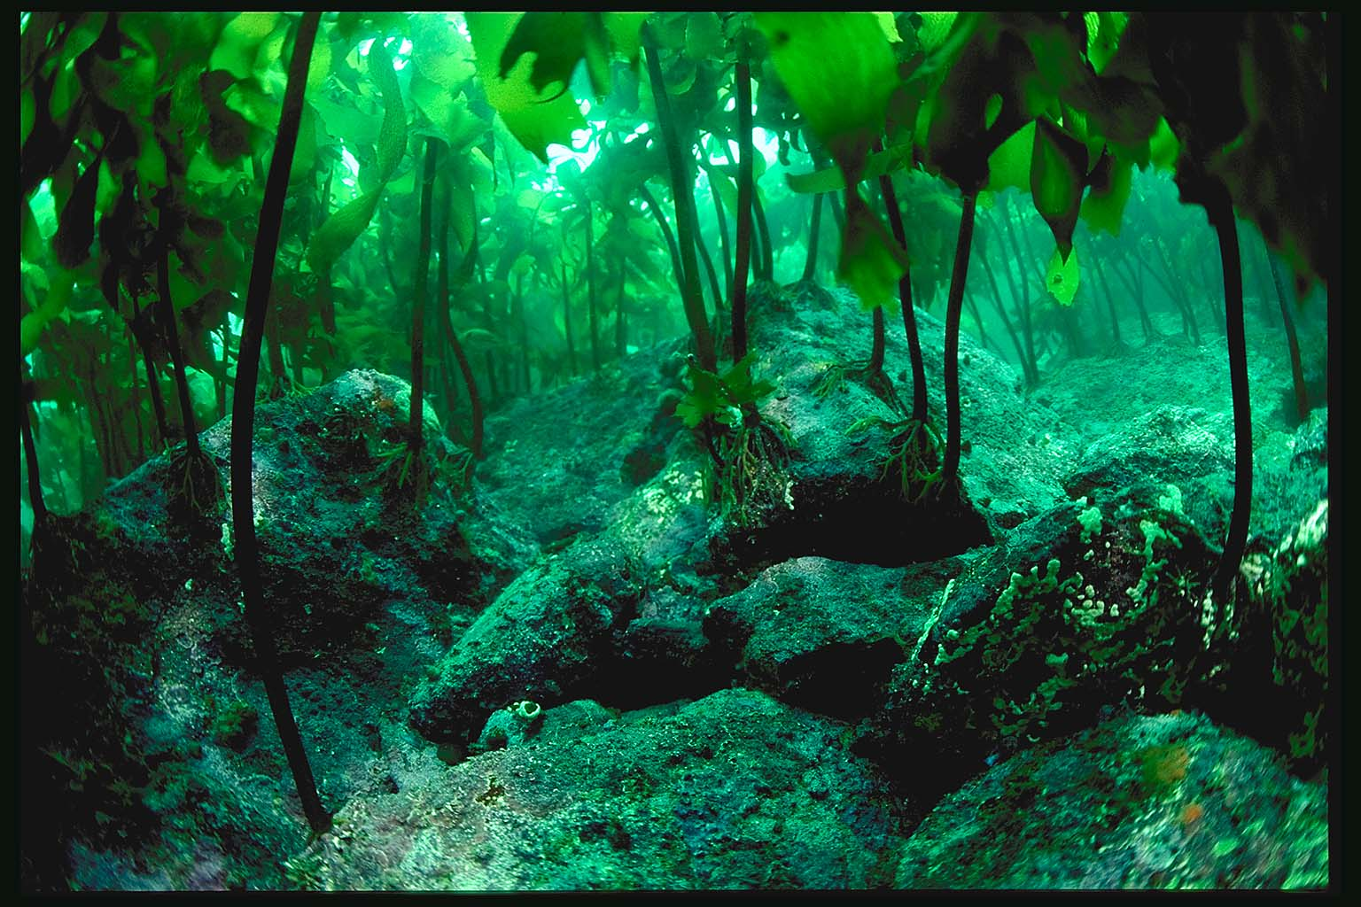
Notes:
Cyanobacteria evolved in the ocean, so it’s probably no surprise that plants thrive in the ocean as well. This undersea forest oxygenates the water and provides nutrients and shelter for marine life.

Slide 10
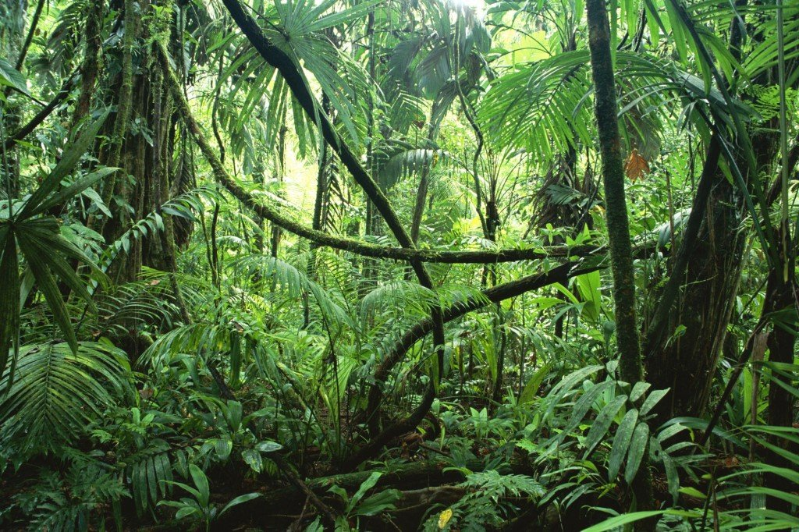
Notes:
Over time, plants evolved to life outside of an aquatic environment. The adaptation of plants to land paved the way for aquatic animals to adapt to land as well. How many different plants can you see in this single picture? Where might this picture have been taken?

Slide 11
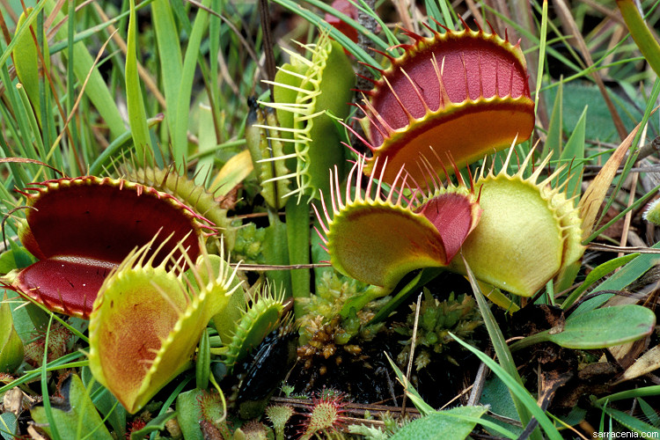
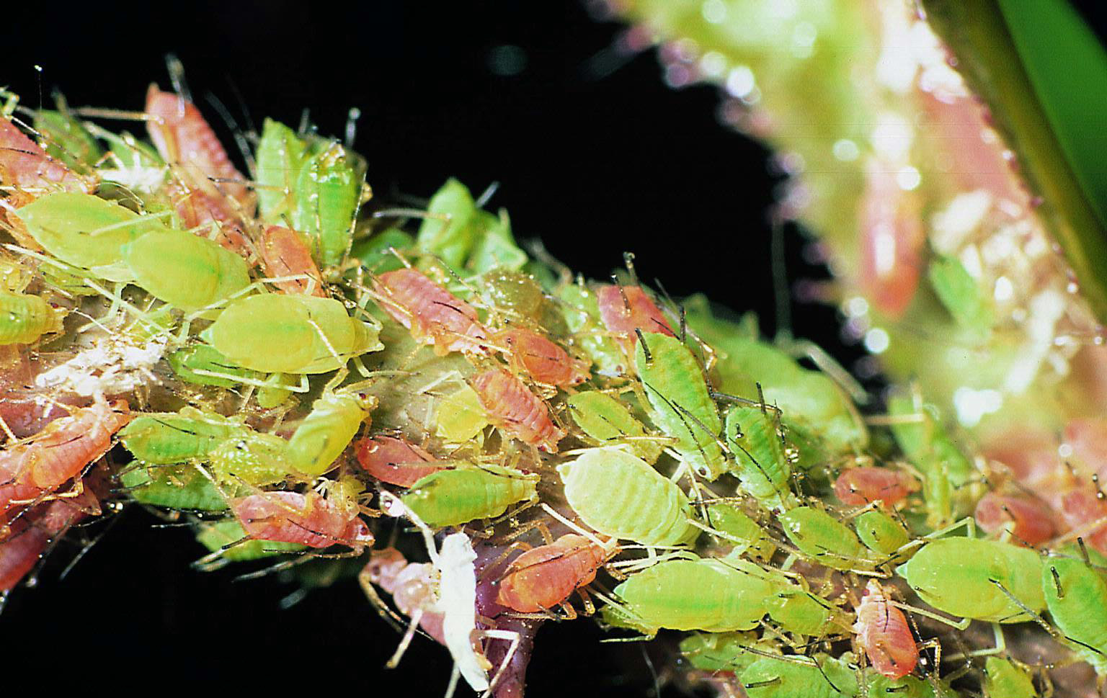
Notes:
Who knows what these are? (Venus fly traps) And these? (Aphids) The co-evolution of plants and insects has led to a number of interesting relationships. Some plants eat insects. Some insects eat plants. Flowering plants rely on insects for pollination and those insects rely on plants for food.

Slide 12
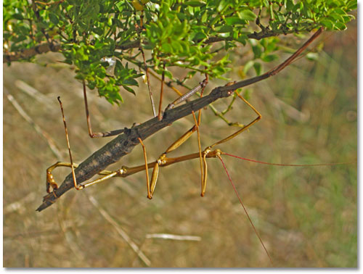
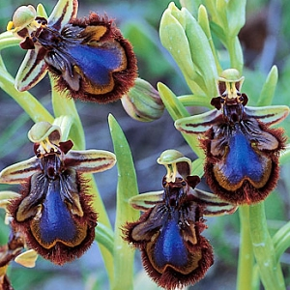
Notes:
What do you see? (Walking stick – looks like a twig) What else? (flowering plant – looks like an insect). These are examples of biomimicry. These organisms have evolved unique traits which have enabled them to survive predation. Can you think of other examples?

Slide 13
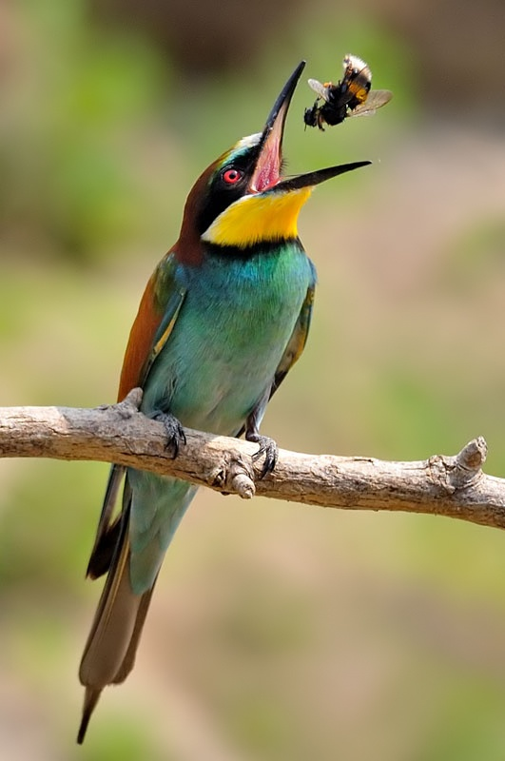
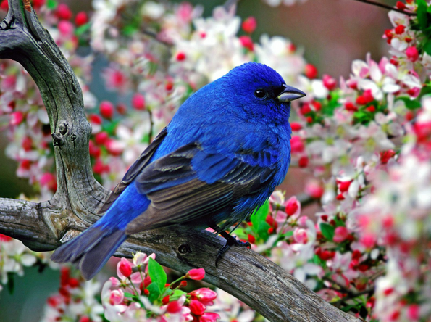
Notes:
Plants also rely on birds to spread seeds. Some plants evolved bright flowers to attract birds, while other plants evolved sugary fruit to attract plants and animals. The fruit is eaten but the seeds are protected by a non-digestible outer coat. The seeds pass through the digestive system and are deposited, along with a load of fertilizer, in a new location away from the original plant. This cooperative relationship allows plants to spread widely without actually having legs, and it provides food for birds and mammals. Did you know birds also eat insects? And worms?

Slide 14
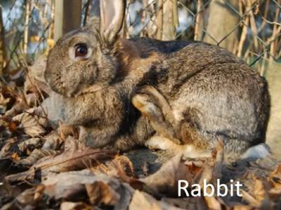
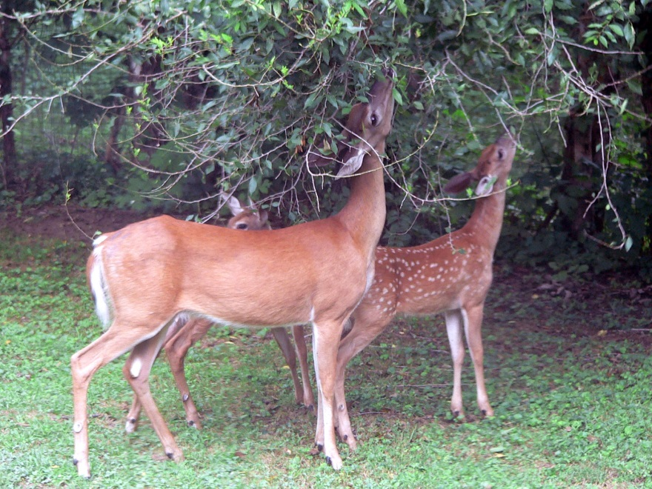
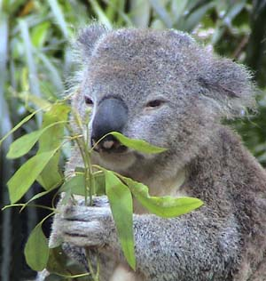
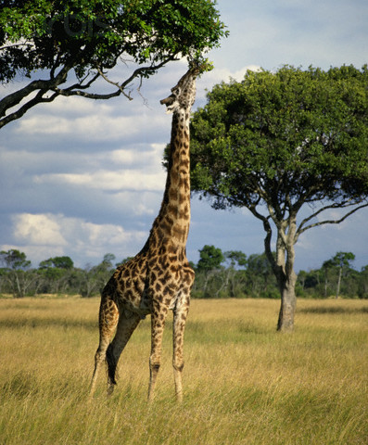
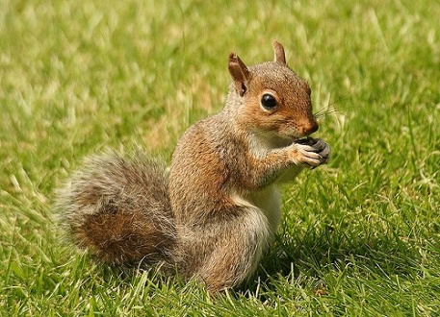
Notes:
Some animals, called herbivores, have evolved to eat plants. Some animals stick close to the ground and eat low-lying plant food. Others climb trees and stash food in safe places to eat later. Giraffes have evolved to extremely long legs and necks to reach foliage way up high in trees.

Slide 15
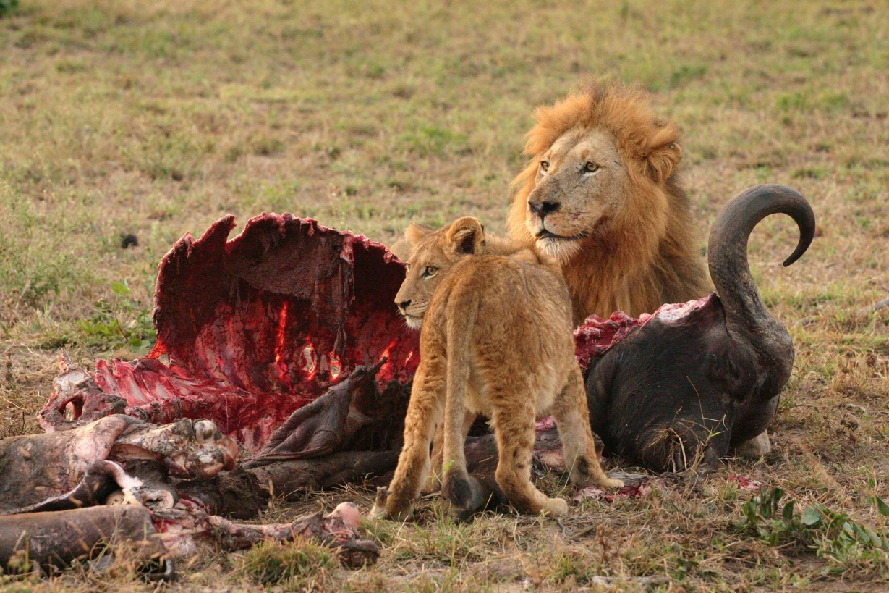
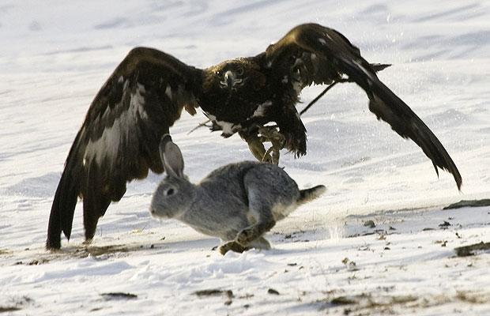
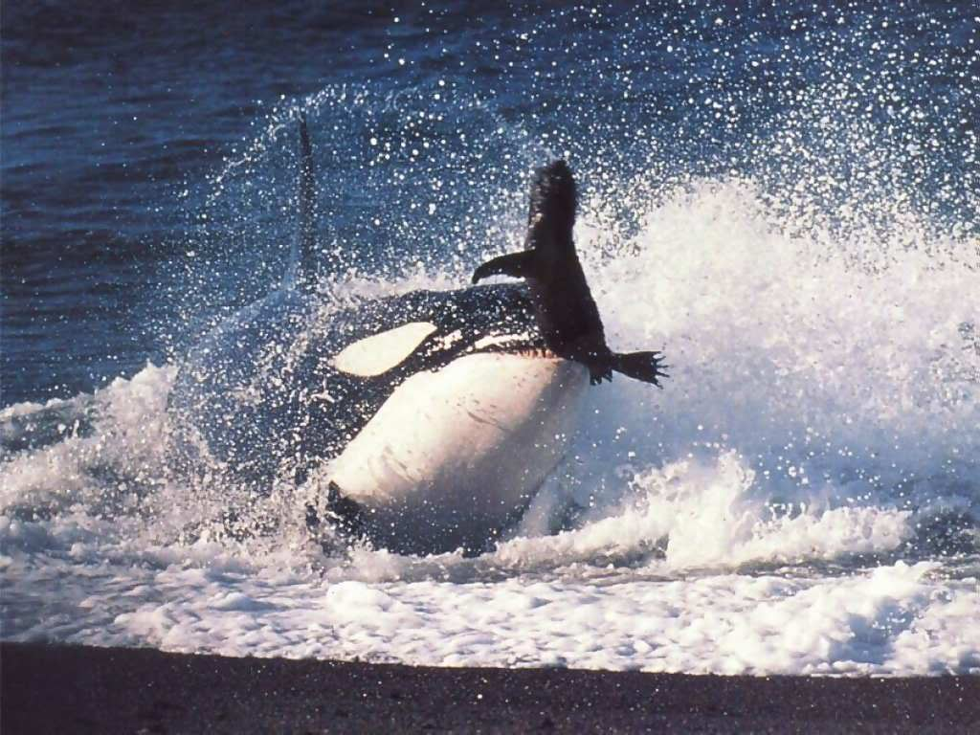
Notes:
Carnivores rely exclusively on meat for their nutrition. These animals are found at the top of their respective food chains.

Slide 16
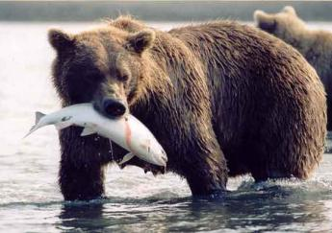
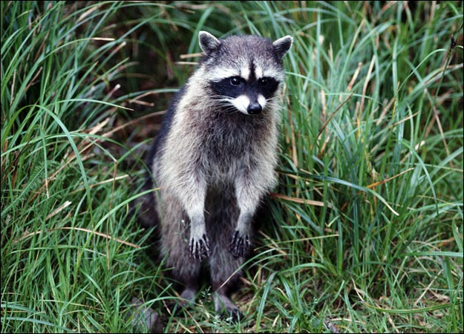
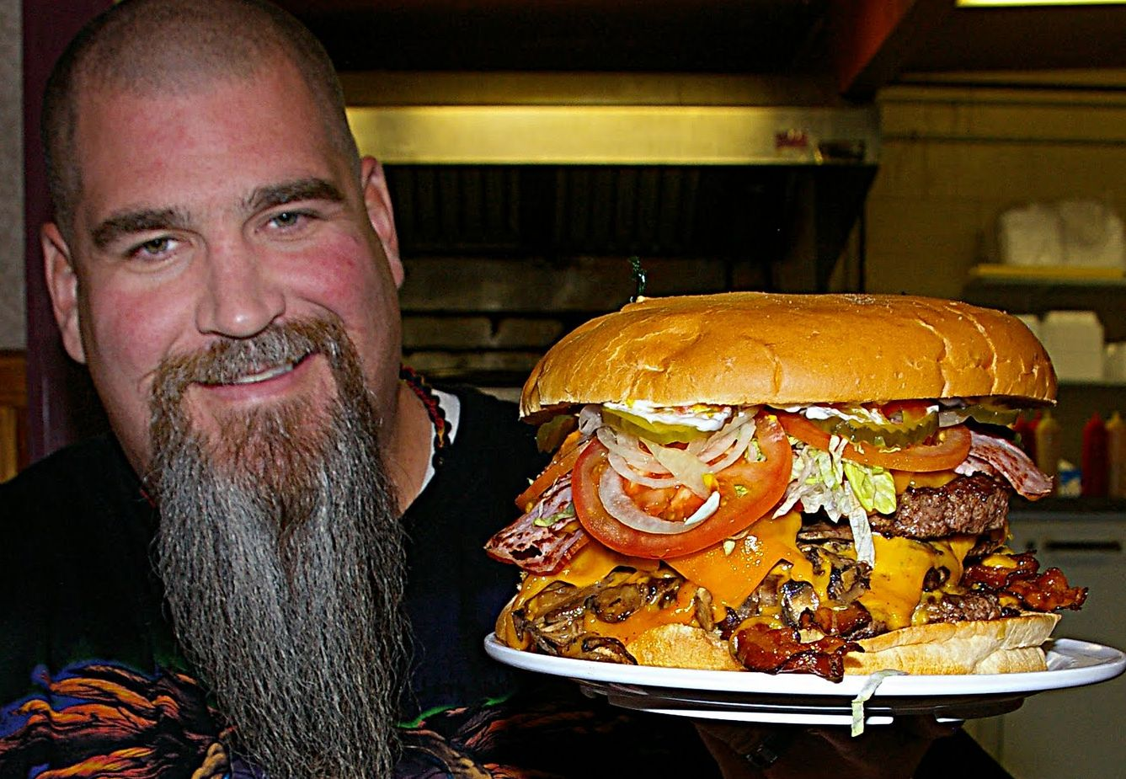
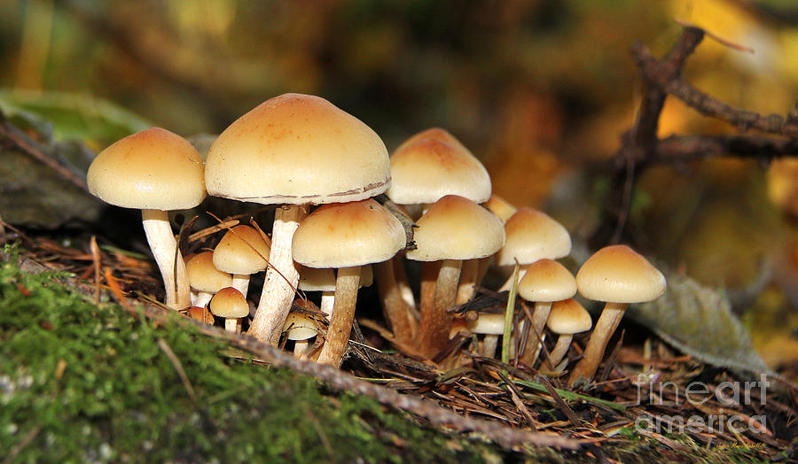
Notes:
Other organisms, called omnivores, have evolved to eat just about anything organic.

Slide 17
Similarities and Differences
Connect the dots! Thinking about the Tree of Life concept, what characteristics can you use to determine how different species are related? How will you represent your data?
Characteristics to consider include:
  Energy source(s)
  Mobility
  Geography
  Reproduction

Slide 18
Debrief
Groups share out
If you were to construct a Tree of Life using one or more of the characteristics presented, which would you use and why?
What information do you need and how would you find it?

