Slide 1
Mitosis & Meiosis
Lesson 6

Slide 2
Quick Review
DNA Structure and Replication
Chromosomes, Genes, mRNA, Proteins
  Central Dogma
  Coding and Non-Coding DNA
  Gene regulation (regulatory sequences, histones)
  Protein structure = function
  Protein expression patterns = unique cell types

Slide 3
Our Road Map
Cell Division
Mitosis
Meiosis
Replication
Heredity
Chromosomes
DNA
Genes
RNA
Traits
Protein

Slide 4
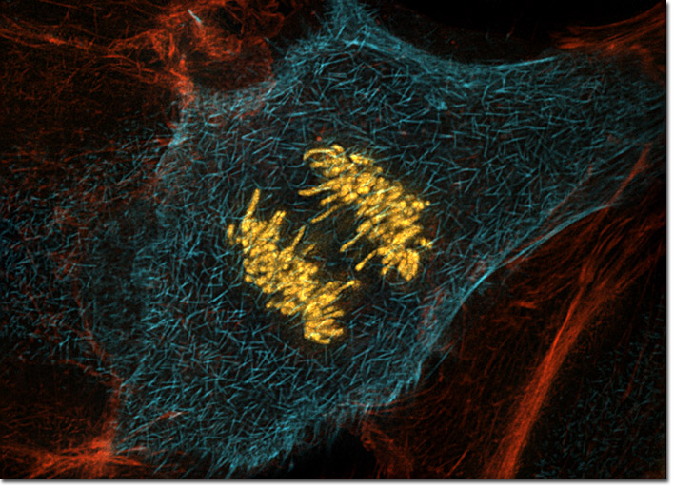
Zoom Out: Cell Division

Slide 5
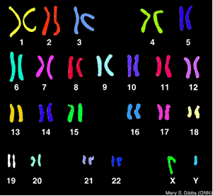
Chromosomes
Humans receive 23 chromosomes from mom and 23 from dad
Autosomal chromosomes are numbered from longest (1) to shortest (22) and pair up as homologous chromosomes
Sex chromosomes include X and Y:
XX for female
XY for male

Slide 6
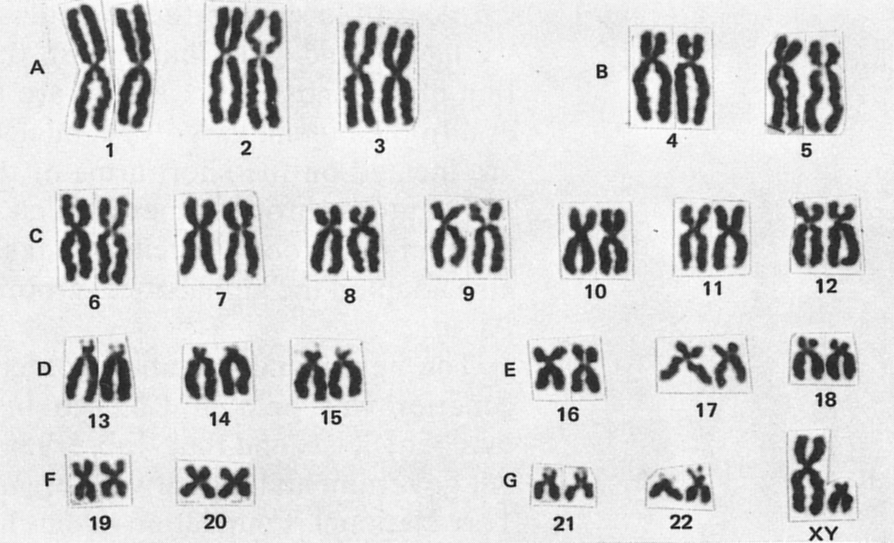
Replicated Chromosomes
Name the structure that links sister chromatids:

Slide 7
Cell Division
Mitosis
Meiosis
The process by which somatic cells (all cells of the body except gametes) divide
23 pairs (46 total) chromosomes after division
Daughter cells are diploid
Two daughter cells are produced from one mitotic cell
The process by which gametes (eggs and sperm) are produced
23 individual chromosomes in a mature gamete
Crossing over ensures genetic diversity
Gametes are haploid
Four gametes are produced from one meiotic cell

Slide 8
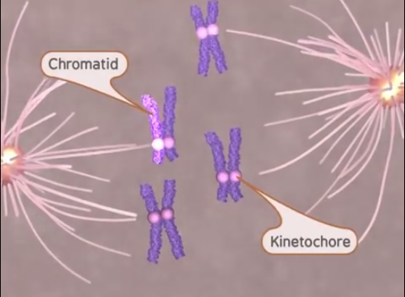
Mitosis
The process by which somatic cells (all cells of the body except gametes) divide
23 pairs (46 total) chromosomes after division
Daughter cells are diploid
Two daughter cells are produced from one mitotic cell
You do not need to memorize the phases!

Slide 9
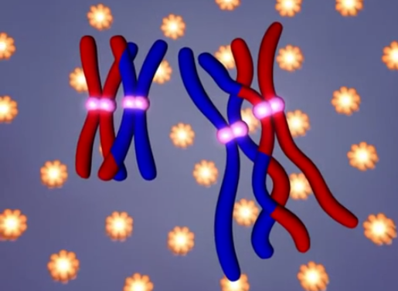
Meiosis
The process by which gametes (eggs and sperm) are produced
23 individual chromosomes in a mature gamete
Crossing over ensures genetic diversity
Gametes are haploid
Four gametes are produced from one meiotic cell
You do not need to memorize the phases!

Slide 10
Need to Know
Key Information
Key Vocabulary
Mitosis results in two identical diploid daughter cells
Meiosis results in four non-identical haploid gametes
Gametes are non-identical because of crossing over, an event where homologous chromosomes exchange DNA segments
Mitosis
Somatic Cell
Diploid
Meiosis
Gamete
Egg / Ovum
Sperm
Haploid
Crossing Over

Slide 11
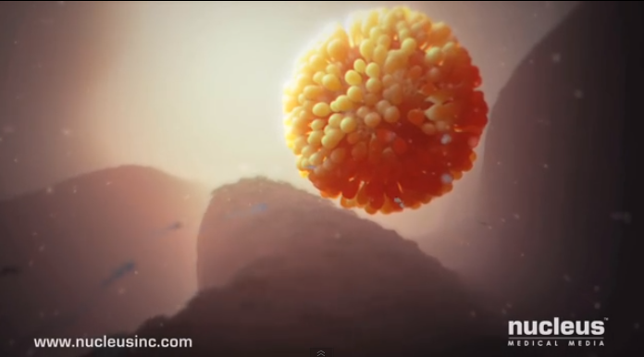
Fertilization
Fertilization: The process in which one egg is fertilized by the winning sperm cell in a race that begins with 300 million sperm cells.

