Slide 1
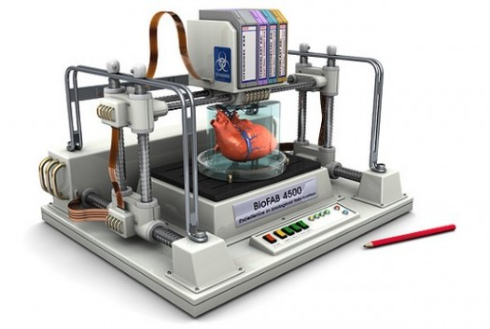

Slide 2
Who is this guy?
My name is David Swart
Married with 3 kids and a dog
Studied immunology in Seattle-area biotech for 15 years
Graduated from MRHS in 1995
Bachelor of Science, Biochemistry, UW, 2000
Biotech Project Management, UW/UCSD, 2008
Master of Pharmaceutical Bioengineering, UW 2011
Post-baccalaureate Science Teacher Certificate, WGU, 2013

Slide 3
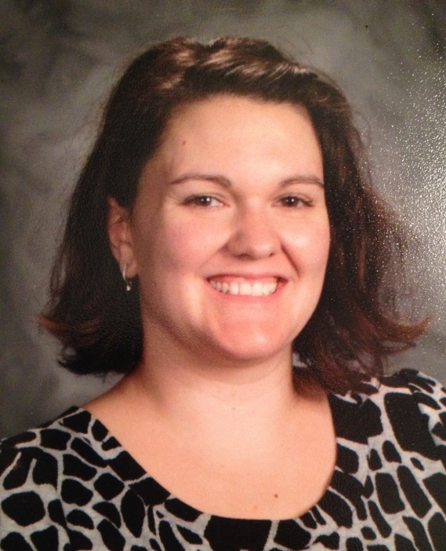
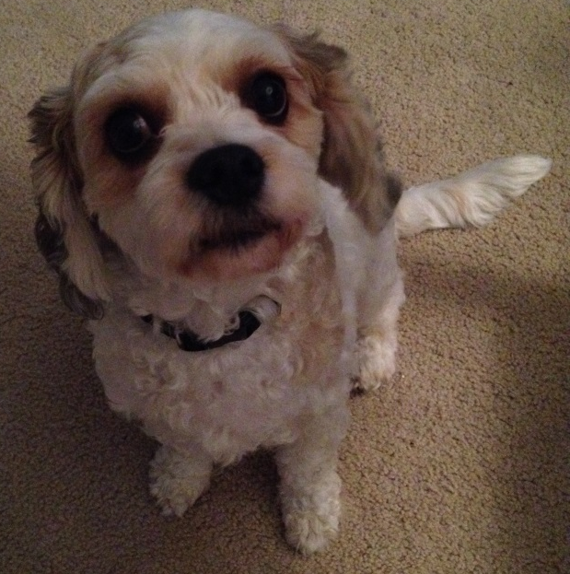
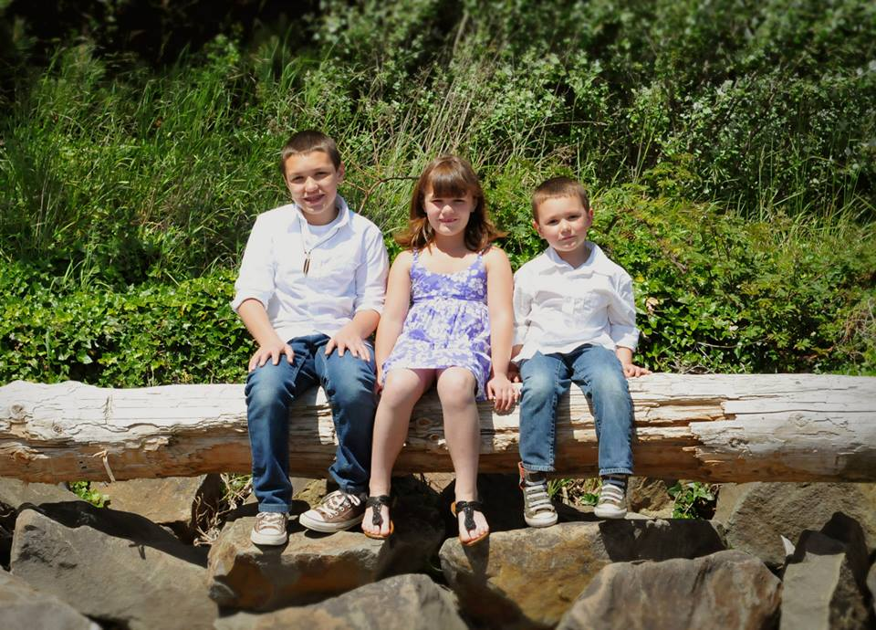

Slide 4
Professional Highlights
Established mouse models of asthma using house dust mite and cockroach allergens
Created systems to investigate cytokine network interactions, focusing on cytokines as adjuvants
Developed in vitro systems to polarize and characterize CD4⁺ T cell subsets
Immunometabolism!

Slide 5
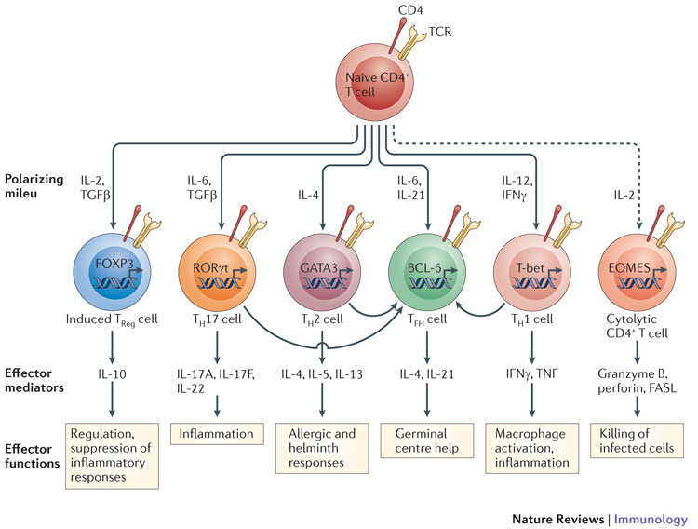

Slide 6
Q&A
What questions do you have for me?
What has been your favorite part of biology so far this year?
What are you most looking forward to learning about in this class?
When you need extra help learning a topic, what resources to you use?

Slide 7
Data Dump: Genetics
Genetics Includes:
Need to Review:
Genes
Chromosomes
Heredity
Dominant
Recessive
Transcription
Translation
Chemistry
Mitosis
Meiosis
Allele

Slide 8
Critter Diagram: About You
Details
Details
Sub-Topic
Details
Name
(Nickname)
Then briefly describe your plans after high school. What will your life look like in 5 years? In 20 years?

Slide 9

National Center for Biotechnology Information
Google: NCBI
Select “Genome” from Popular Resources
Select “Human Genome”
Click on a chromosome
Investigate a gene! Try to drill down to the actual ATCG sequence.
http://www.ncbi.nlm.nih.gov/

